Slide 1
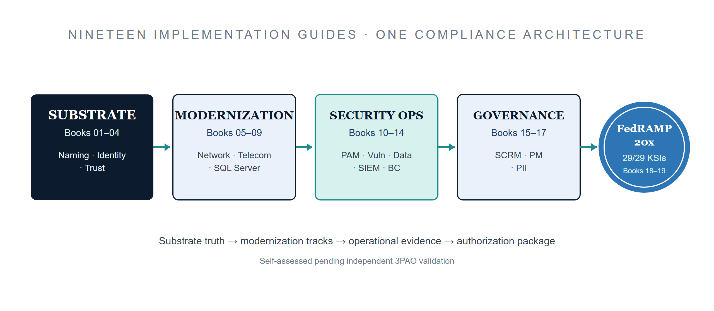
CSI TEAM DRAFT PROPOSAL — SUBJECT TO REVIEW · INTERNAL — NOT FOR PUBLIC DISTRIBUTION
Federal Application-Aware Networking
Executive Summary — The FedRAMP 20x Compliance Roadmap · Books 00–19
NIST SP 800-53 Rev 5 · FedRAMP 20x Consolidated Rules (June 25, 2026) · Mandatory January 1, 2027 · Date Code 2026-07-07 15:28 ET
Notes:
ABOUT THIS DOCUMENT Developed by the CSI Team (Cloud Services Infrastructure) as a technical planning document for SSA's FedRAMP 20x compliance transition: an SSA-wide analysis of the architectural work required to satisfy NIST SP 800-53 Rev 5 controls and FedRAMP 20x Key Security Indicators under the Consolidated Rules effective January 1, 2027. Audience: authorizing officials, program executives, and budget decision makers. Status: DRAFT PROPOSAL — not reviewed or approved by the SSA CIO Office, the Office of Information Security (OIS), or organizational leadership. All recommendations, vendor selections, control mappings, and implementation timelines are subject to revision pending formal review. The series: nineteen companion implementation guides (Books 01-19) plus this executive summary (Book 00), organized in four bands — Substrate (01-04: naming, identity, and trust foundations), Modernization Tracks (05-09: closing 34 distinct NIST controls across the original six tracks), Security Operations (10-14: ~55 additional controls across AC, RA, MP, SC, AU, SI, IR, CP), Risk & Program Governance (15-17: SR, PM, PT families) — plus Book 18 (Training, AT family) and Book 19 (Authorization Package & ConMon). Together the nineteen books constitute the complete evidence-generation and authorization layer required for FedRAMP 20x continuous-monitoring authorization. Each book maps its implementations directly to the controls it closes; Book 19 assembles those mappings into a machine-readable OSCAL authorization package ready for 3PAO validation. Three technologies recur throughout as the ONLY closure mechanisms for their control sets (not preferred options among several): IPAM/DDI, SD-WAN, and TIC 3.0 — see the Closure Necessity slide.
Vendor sources: https://www.fedramp.gov/20x/ | https://csrc.nist.gov/pubs/sp/800/53/r5/upd1/final

Slide 2
A Draft Proposal, Not a Mandate
What this is
This roadmap will necessarily be modified as it is reviewed by:
A comprehensive technical roadmap — twenty implementation areas mapped to NIST SP 800-53 Rev 5 control families and FedRAMP 20x Key Security Indicators, with closure mechanisms and sequencing against the regulatory timeline.
CIO
CIO Office
Strategic direction, enterprise architecture alignment, and prioritization
What this is not
OIS
Office of Information Security
A final implementation mandate, an organizational assignment of responsibilities, or a procurement decision. Security policy authority, control ownership, budget, and accountability span multiple organizations.
Security policy, control ownership, assessment methodology, risk acceptance
ORG
Organizational leaders
Operational feasibility, resource capacity, accountability mapping
Not yet reviewed by OIS
The Office of Information Security will have substantial influence over the security architecture, policy framework, and control ownership described here. That review — and OIS's active participation — is a required step before any commitments are made.
Program offices
PGM
System-specific control applicability and implementation sequencing
The compliance timeline is not advisory. January 1, 2027 is a regulatory requirement — the architectural gap is real, and the window to close it is closing.
Federal AAN — Executive Summary · CSI Team Draft — Internal, Not for Public Distribution · Date Code 2026-07-07 15:28 ET
2
Notes:
WHAT THIS IS: a comprehensive technical roadmap — twenty implementation areas mapped to specific control families, closure mechanisms identified, and the work sequenced against the regulatory timeline. An attempt at a true enterprise-wide view, not a CSI-scoped one. WHAT THIS IS NOT: a final implementation mandate, an organizational assignment of responsibilities, or a procurement decision. The CSI Team does not hold authority over the full scope this series describes. Security policy authority, control ownership, budget authority, and implementation accountability span multiple organizations and must be established through a formal alignment process. OIS AND SECURITY LEADERSHIP: OIS will have substantial influence over the security architecture, policy framework, and control ownership decisions described in this series. This document has NOT yet been reviewed by OIS. That review — and OIS's active participation in shaping the implementation approach — is a required step before any commitments are made. EXPECTED REVISION PROCESS — this roadmap will necessarily be modified as it is reviewed by: - CIO Office: strategic direction, enterprise architecture alignment, prioritization. - OIS: security policy, control ownership, assessment methodology, risk acceptance authority. - Organizational leaders: operational feasibility, resource capacity, accountability mapping across SSA's organizational units. - Program offices: system-specific applicability of the recommended controls and implementation sequencing. THE TIMELINE IS NOT ADVISORY: the FedRAMP 20x mandatory date of January 1, 2027 is a regulatory requirement, not an internal target. The architectural gap this series describes is real, and the window to close it is closing. This roadmap does not reduce that urgency — it maps the path. Closing it requires alignment and action across all organizations named above. VENDOR SELECTION STATUS: SD-WAN and SASE SSE vendor selections are pending agency procurement review. Shortlists reflect FedRAMP authorization status and federal use-case alignment at time of writing; final selection requires validation against current FedRAMP Marketplace listings, agency-specific environment testing, and applicable procurement authority. All KSI self-assessments are self-assessed pending independent 3PAO validation.
Vendor sources: uiao repo: inbox/Application Aware Networking/Book_00_FedAAN_Executive_Summary.qmd

Slide 3
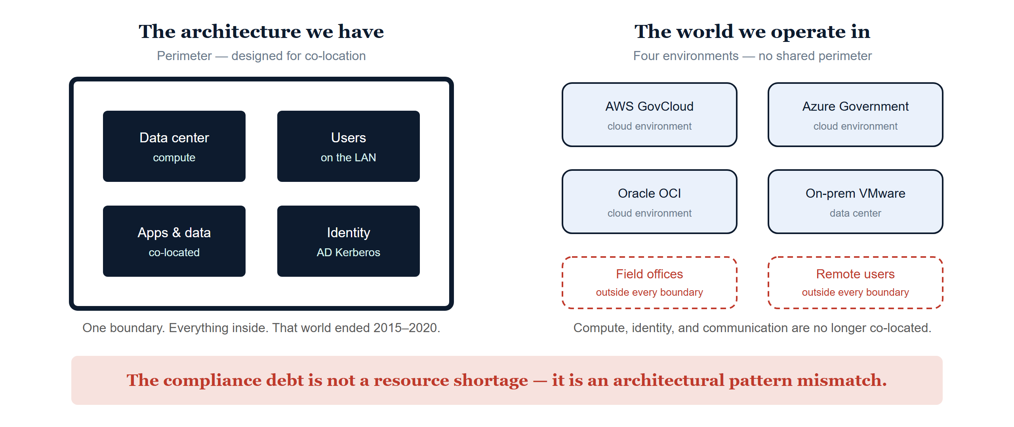
The Central Finding
The same conclusion across all nineteen books
Federal AAN — Executive Summary · CSI Team Draft — Internal, Not for Public Distribution · Date Code 2026-07-07 15:28 ET
3
Notes:
THE CENTRAL FINDING (identical across all six original documents): the compliance debt is not a resource shortage — it is an architectural pattern mismatch. The existing infrastructure was designed for a world where compute, identity, and communication were co-located inside a perimeter. That world ended between 2015 and 2020. The controls federal agencies are now required to satisfy — Zero Trust Executive Order 14028 (May 12, 2021), OMB M-22-09, TIC 3.0, and FedRAMP 20x Consolidated Rules (June 25, 2026) — CANNOT be satisfied by the perimeter architecture. They require a different structural foundation. LEFT PANEL: the perimeter model. One boundary; data center, users, apps and data, and identity (AD Kerberos) all co-located inside it. Active Directory Kerberos is a session-based, network-location-dependent authentication protocol that breaks structurally when client and server are separated by cloud, VPN, or multi-path SD-WAN (Part 5/Part 6 document the mechanism). RIGHT PANEL: the agency now operates four environments simultaneously — AWS GovCloud, Azure Government, Oracle OCI, and on-premises VMware — plus field offices and remote users that sit outside every boundary. The authentication and enforcement model has not been updated to match. BOTTOM LINE: the nineteen implementations described in this series are not optional modernization projects. They are the structural prerequisites for operating at FedRAMP Moderate authorization under FedRAMP 20x rules, which are mandatory for all certified systems effective January 1, 2027.
Vendor sources: uiao repo: inbox/Application Aware Networking/Book_00_FedAAN_Executive_Summary.qmd

Slide 4
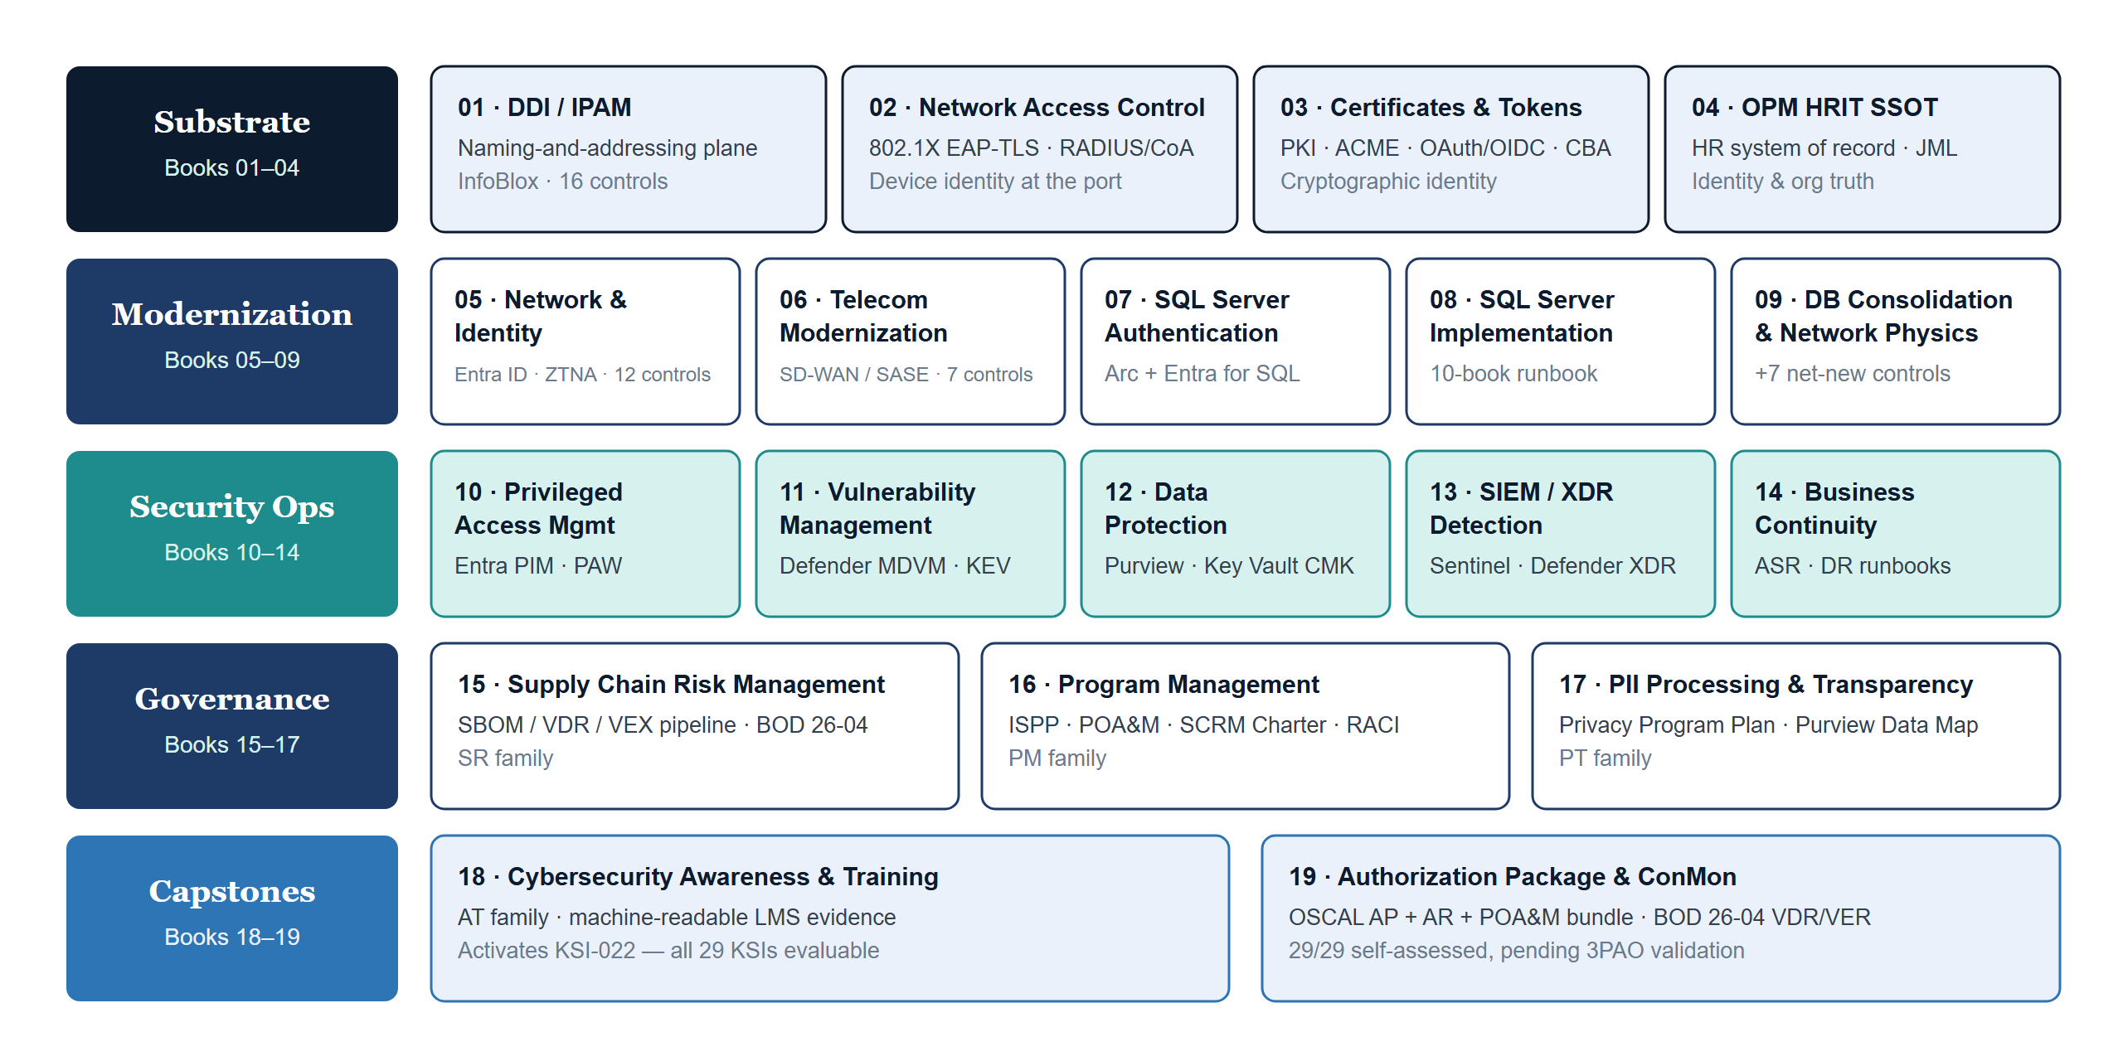
Nineteen Books, One Compliance Architecture
Four bands plus two capstones — each book maps its implementations to the controls it closes
Federal AAN — Executive Summary · CSI Team Draft — Internal, Not for Public Distribution · Date Code 2026-07-07 15:28 ET
4
Notes:
PER-PART DOMAIN AND CORE TECHNOLOGY (Series Overview table): - Part 1 SSA Landing Zone IPAM/FedRAMP: DNS, DHCP, IPAM, PKI, Zero Trust — InfoBlox DDI. Closes 16 NIST controls. - Part 2 Network Access Control: 802.1X EAP-TLS, RADIUS/CoA, DHCP fingerprinting, NAC policy tiers — 802.1X + RADIUS + Intune SCEP. IA-3 and CM-8 are necessity closures. - Part 3 Certificates & Tokens: PKI lifecycle, ACME automation, OAuth 2.0/OIDC, CBA, workload identity — Entra ID CBA + ACME + managed identity. - Part 4 OPM HRIT Identity & Org SSOT: HR system of record, joiner/mover/leaver lifecycle, org hierarchy as queryable truth — Oracle HCM Cloud + Entra inbound provisioning. AC-2 and PS-4 are necessity closures. - Part 5 Network Modernization: identity, governance, AD modernization — Entra ID, ZTNA, Active Governance. 12 controls. - Part 6 Federal Telecommunications Modernization: Amazon Connect, Teams Phone, SD-WAN, SASE. 7 controls. - Part 7 SQL Server Authentication Modernization: SQL credential elimination, Arc Managed Identity, NTLM elimination. - Part 8 SQL Server Implementation Guide: 10-book runbook — estate audit, Arc deployment, login migration, monitoring. - Part 9 Database Consolidation & Network Physics: SSOT architecture, SD-WAN for database traffic, consistency class alignment. +7 net-new controls (series total 34 distinct). - Part 10 PAM: Entra PIM JIT activation, PAW architecture, AC-6 least privilege. - Part 11 Vulnerability Management: Defender MDVM, CISA KEV integration, RA-5 continuous scanning. - Part 12 Data Protection: Purview DLP, sensitivity labels, Key Vault CMK — MP/SC controls. - Part 13 SIEM/XDR: Sentinel connectors, KQL analytics rules, UEBA scoring, Logic App playbooks. - Part 14 Business Continuity: CP-2 contingency plan, BIA RTO/RPO/MTD, SQL AG and DDI DR integration — Azure Site Recovery + DR runbooks. - Part 15 SCRM: Syft CycloneDX SBOM, Grype VDR, OpenVEX, GitHub Actions pipeline — BOD 26-04 / SR family. - Part 16 Program Management & Governance: ISPP, POA&M, SCRM Charter, Leadership RACI — PM family. - Part 17 PII Processing & Transparency: PT family templates, Privacy Program Plan, authority-to-process, Purview Data Map — PT-1..PT-7 GCC Moderate. - Part 18 Cybersecurity Awareness & Training: AT-2/AT-3 general and role-based training, LMS evidence schema, CP-3 tabletop calendar, IR-2 drills. ACTIVATES KSI-022 (KSI-CED-RAT) — the last scaffolded KSI — making all 29 CR26 KSIs evaluable at high confidence. - Part 19 Authorization Package & ConMon: OSCAL AP+AR+POA&M bundle (29/29 self-assessed, pending 3PAO), BOD 26-04 VDR/VER submission, CA-7 ConMon program — closes CA-2, CA-5, CA-6, CA-7, RA-3, SA-15. Vendor sources: https://marketplace.fedramp.gov/ (product authorization status) · https://www.infoblox.com/ · https://learn.microsoft.com/en-us/entra/ · https://learn.microsoft.com/en-us/azure/azure-arc/ · https://learn.microsoft.com/en-us/azure/sentinel/ · https://learn.microsoft.com/en-us/purview/ · https://www.oracle.com/human-capital-management/

Slide 5
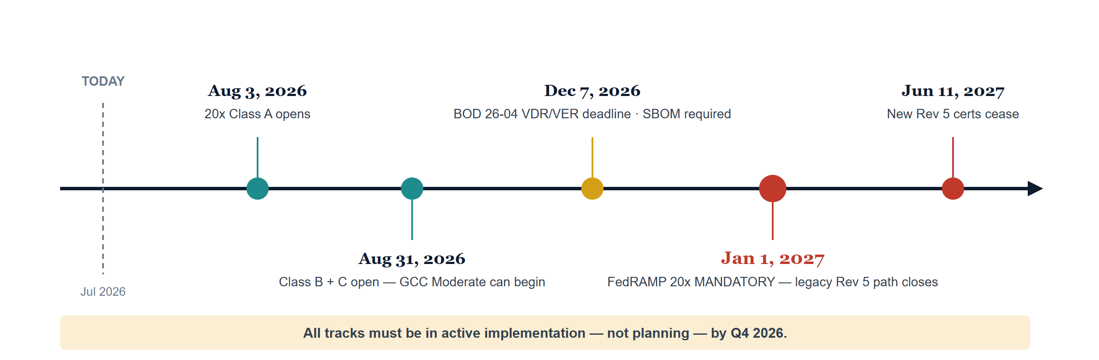
FedRAMP 20x Hard Deadlines
Agencies without machine-readable KSI evidence underway by Q3 2026 face authorization gaps at renewal
The nineteen implementations are not optional modernization projects. They are the structural prerequisites for operating at FedRAMP Moderate under 20x rules, mandatory for all certified systems on January 1, 2027.
Federal AAN — Executive Summary · CSI Team Draft — Internal, Not for Public Distribution · Date Code 2026-07-07 15:28 ET
5
Notes:
FEDRAMP 20x HARD DEADLINES (verbatim from Book 00): - Aug 3, 2026 — FedRAMP 20x Class A opens: first submission window for new authorizations. - Aug 31, 2026 — Class B + C open: GCC Moderate systems can begin. - Dec 7, 2026 — BOD 26-04 VDR/VER deadline: SBOM + vendor disclosure required; KSI-011 through KSI-014 become evaluable. - Jan 1, 2027 — FedRAMP 20x MANDATORY: all new authorizations must use 20x; the legacy Rev 5 path closes. - Jun 11, 2027 — new Rev 5 certifications cease: no new legacy authorizations after this date. IMPLICATIONS: agencies that have not begun the transition to machine-readable KSI evidence by Q3 2026 will face authorization gaps at renewal. All tracks must be in ACTIVE IMPLEMENTATION — not in planning — by Q4 2026. Under FedRAMP 20x, POA&M items no longer trigger periodic remediation deadlines — they trigger continuous evidence collection requirements. An open CM-8 finding requires a continuous, machine-readable inventory update process, not a one-time scan. Findings that require manual evidence assembly cannot satisfy KSI requirements.
Vendor sources: https://www.fedramp.gov/20x/

Slide 6
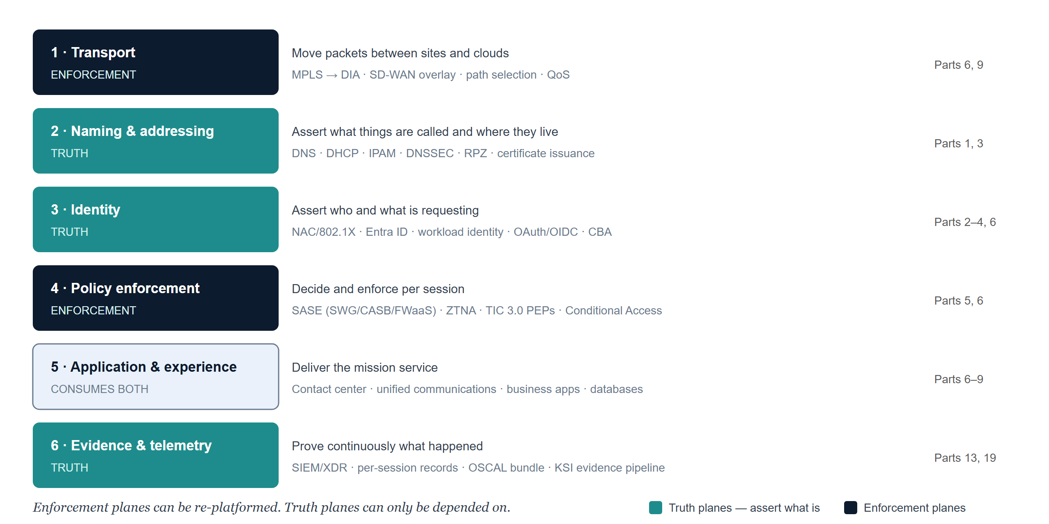
The Six Functional Planes
Functions, not organizations — any agency can map its own structure onto the model
Federal AAN — Executive Summary · CSI Team Draft — Internal, Not for Public Distribution · Date Code 2026-07-07 15:28 ET
6
Notes:
THE FUNCTIONAL PLANE MODEL: this series describes functions, not organizations. The planes are architectural facts — they exist in every enterprise regardless of how the org chart divides them — so any agency can map its own structure onto the model without the model taking a position on whose structure is correct. Representative capabilities per plane: 1 Transport (ENFORCEMENT): circuits, MPLS-to-DIA, SD-WAN overlay, path selection, QoS. Series home: Parts 6, 9. 2 Naming & addressing (TRUTH): DNS, DHCP, IPAM, DNSSEC, RPZ, certificate issuance (DDI + PKI). Parts 1, 3. 3 Identity (TRUTH): device identity (NAC/802.1X), user identity (Entra ID), workload identity, tokens (OAuth/OIDC, CBA). Parts 2, 3, 4, 6. 4 Policy enforcement (ENFORCEMENT): SASE (SWG/CASB/FWaaS), ZTNA, TIC 3.0 PEPs, Conditional Access. Parts 5, 6. 5 Application & experience (consumes both): contact center, unified communications, business applications, databases. Parts 6-9. 6 Evidence & telemetry (TRUTH): SIEM/XDR, per-session records, OSCAL bundle, KSI evidence pipeline. Parts 13, 19. THE HIERARCHY: the planes are not peers. The organizing principle — separate truth from enforcement — imposes it: planes 2, 3, 6 are truth planes (they assert what is); planes 1, 4 are enforcement planes (they act on those assertions); plane 5 consumes both. Why it matters: enforcement planes can be re-platformed, absorbed, or replaced — MPLS became SD-WAN; the VPN concentrator became ZTNA; the branch firewall became a SASE PoP — while truth planes can only be DEPENDED ON. Every enforcement decision in this architecture resolves a name, validates a certificate, or evaluates a token before it acts. The truth planes are where the architecture's authority lives; the enforcement planes are where its will is done.
Vendor sources: uiao repo: inbox/Application Aware Networking/Book_00_FedAAN_Executive_Summary.qmd

Slide 7
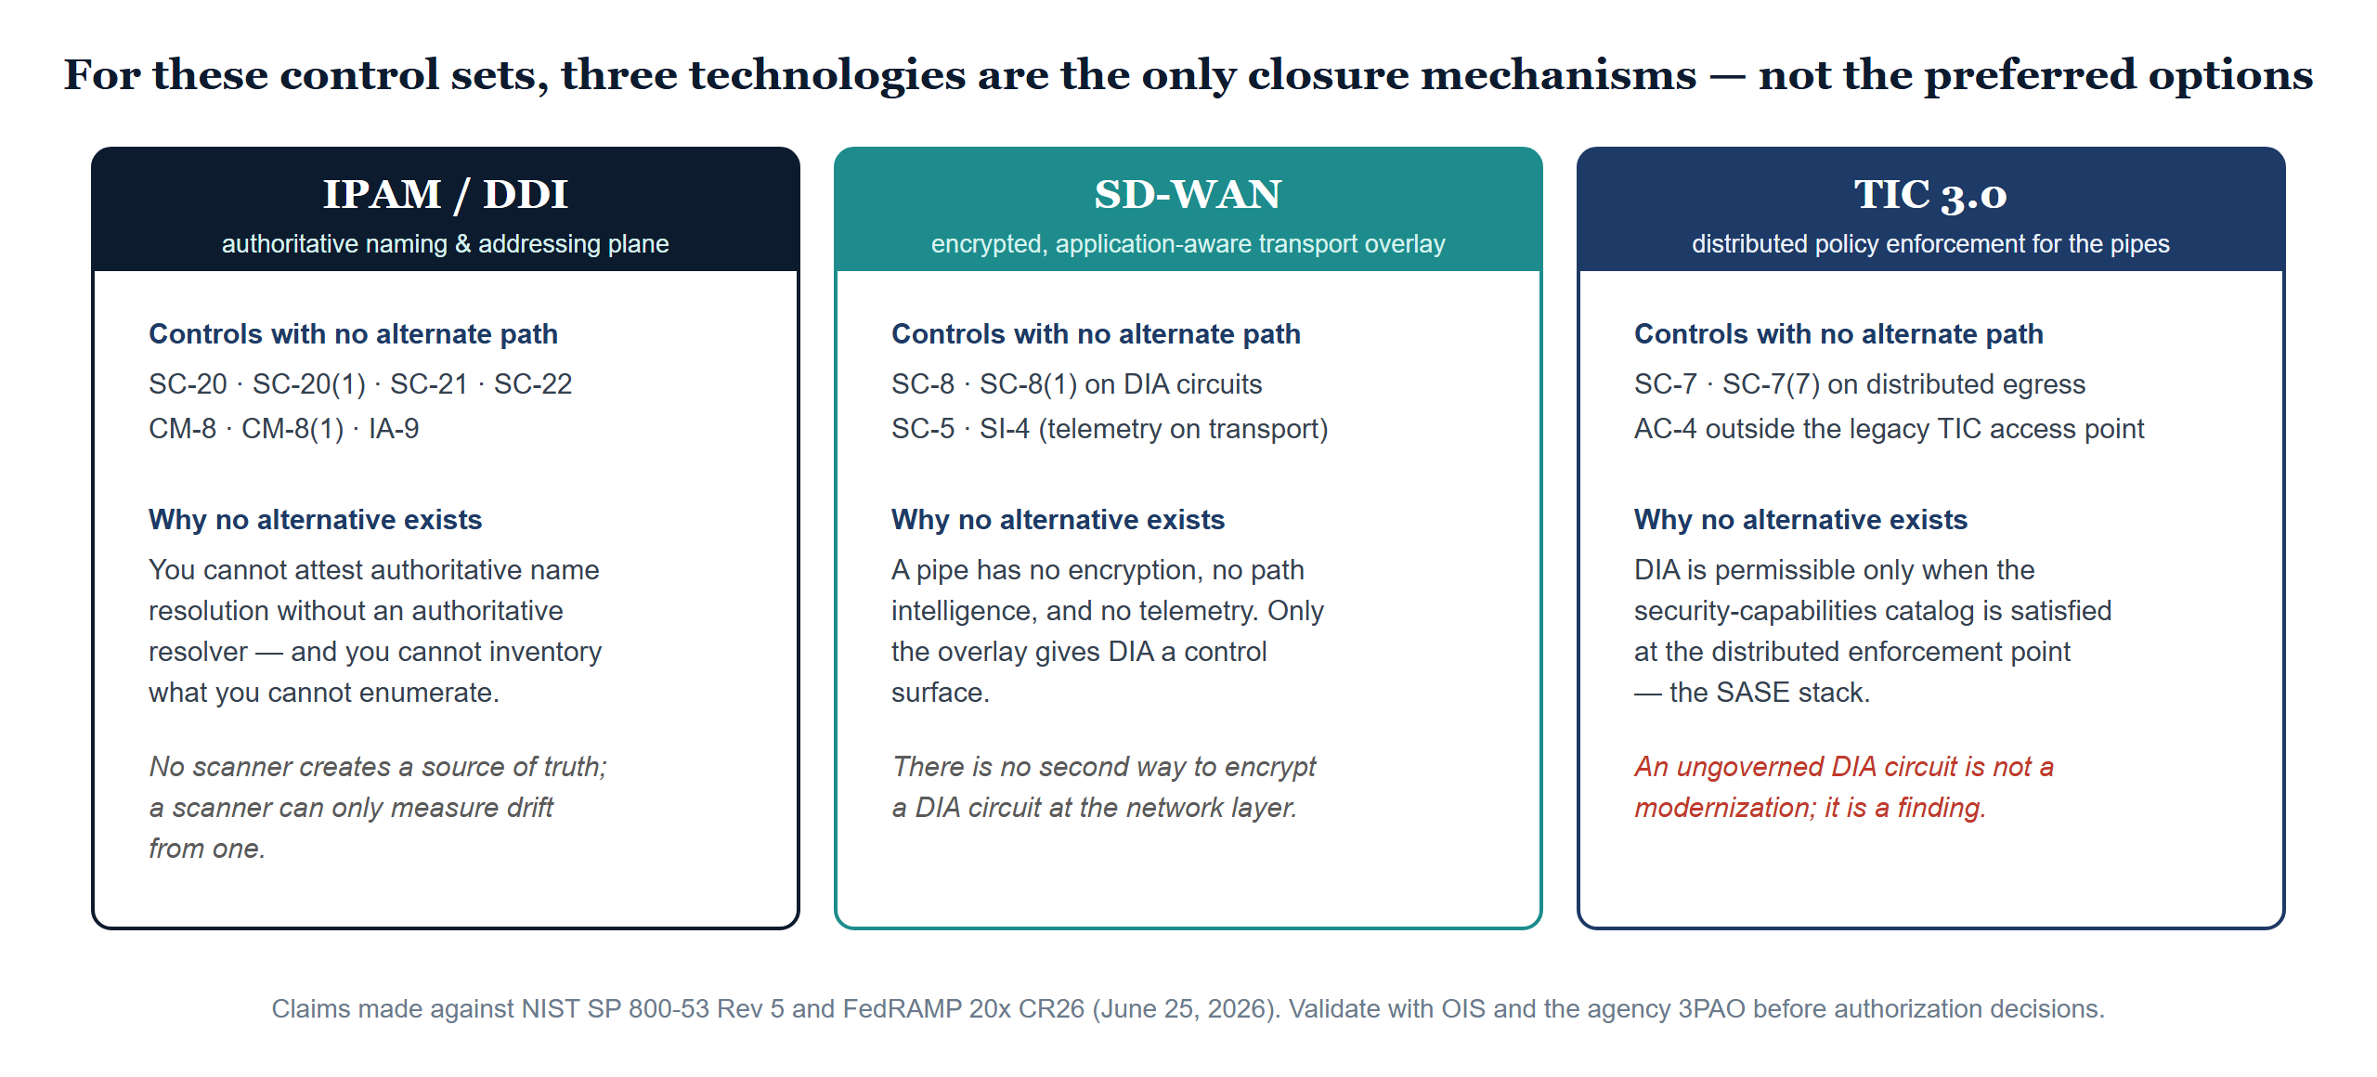
The Closure Necessity Doctrine
A falsifiable claim: every “required” pairs with control text, physics, or protocol behavior — never an adjective
Federal AAN — Executive Summary · CSI Team Draft — Internal, Not for Public Distribution · Date Code 2026-07-07 15:28 ET
7
Notes:
THE CLOSURE NECESSITY DOCTRINE — the claim is stronger than "recommended" and it is falsifiable: for a specific, enumerable set of NIST SP 800-53 Rev 5 controls, three technologies are the ONLY closure mechanisms. Every "required" in the series pairs with the control text, physics, or protocol behavior that makes the alternatives impossible — never with an adjective.
1. IPAM/DDI (authoritative naming-and-addressing plane). Controls with no alternate closure path: SC-20, SC-20(1), SC-21, SC-22 (authoritative/recursive DNS); CM-8, CM-8(1) (component inventory); IA-9 (service identification). Why: you cannot attest authoritative name resolution without an authoritative resolver, and you cannot inventory what you cannot enumerate. No scanner creates a source of truth — a scanner can only measure drift from one.
2. SD-WAN (encrypted, application-aware transport overlay). Controls: SC-8, SC-8(1) on DIA circuits (network-layer encryption); SC-5 (traffic-class separation); SI-4 (application-layer telemetry on transport). Why: a pipe has no encryption, no path intelligence, and no telemetry. Physics gives DIA lower latency; only the overlay gives it a control surface. There is no second way to encrypt a DIA circuit at the network layer.
3. TIC 3.0 (distributed policy enforcement for the pipes). Controls: SC-7, SC-7(7) (boundary protection on distributed egress); AC-4 (information flow enforcement outside the legacy TIC access point). Why: under TIC 3.0, DIA is permissible ONLY WHEN the security-capabilities catalog is satisfied at the distributed enforcement point — the SASE stack. An ungoverned DIA circuit is not a modernization; it is a finding.
BASELINE CAVEAT: these closure claims are made against the NIST SP 800-53 Rev 5 baseline and FedRAMP 20x CR26 rules effective June 25, 2026. Changes to the baseline, new FedRAMP-authorized product entries, or revised assessment guidance may alter these closure paths. Validate with OIS and the agency's 3PAO before using these claims as the basis for authorization decisions.
The KSI Closure Necessity Matrix (slide 10) quantifies this doctrine against all 29 FedRAMP 20x KSI rules.
Vendor sources: https://csrc.nist.gov/pubs/sp/800/53/r5/upd1/final | uiao repo: inbox/Application Aware Networking/Book_00_FedAAN_Executive_Summary.qmd
MECHANISM, NOT PRODUCT (added 2026-07-07, SSA review response — mirrors the new Book 00 callout): 'no alternate closure path' is a claim about mechanism classes, never vendors. Every product named in the series is a deployed example of its mechanism, and FedRAMP-authorized alternatives exist at every layer — the alternatives matrix in the ConMon Gap Roadmap enumerates them (DDI, NAC/RADIUS, SD-WAN, SASE, IdP, HCM, SIEM, PAM, CLM, MDM). The program doctrine: multiple compliant paths exist before the agency chooses; exactly one exists after — the selected path becomes mandatory once chosen, because split implementations of a truth plane recreate the fragmented-truth problem the series exists to end. If a reviewer or leader reads the necessity table as vendor lock-in, this is the standing correction.

Slide 8
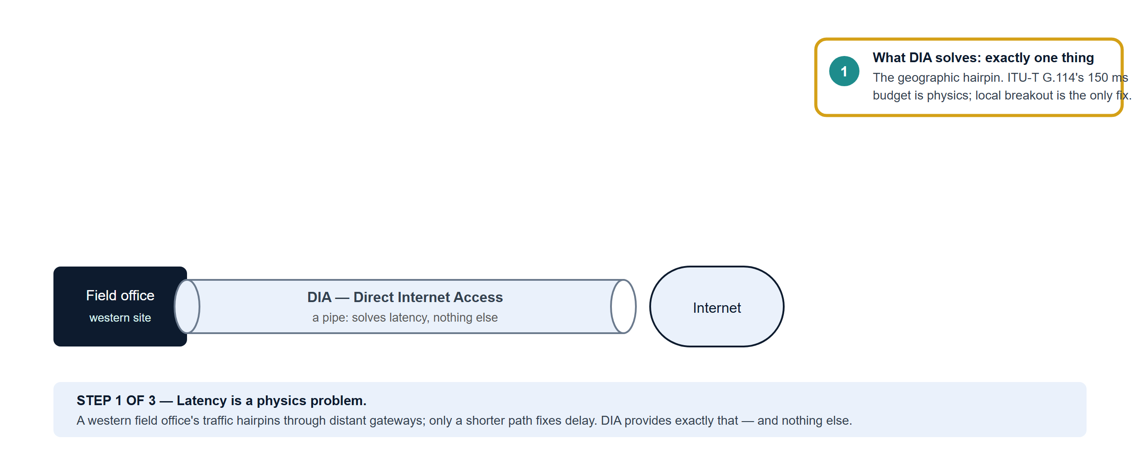
DIA Is a Pipe — The Three-Step Argument
Direct Internet Access solves the latency problem; the governance stack satisfies the controls
Federal AAN — Executive Summary · CSI Team Draft — Internal, Not for Public Distribution · Date Code 2026-07-07 15:28 ET
8
Notes:
BUILD 1 OF 3 — What DIA solves: exactly one thing. The geographic hairpin. ITU-T G.114 sets a 150 ms one-way delay budget for voice, and western field offices exceed it before a call connects because traffic hairpins through distant MPLS/TIC gateways. Local breakout — a DIA circuit — shortens the fiber path: Portland to AWS us-west-2 drops from 100-130 ms over MPLS to 5-15 ms over DIA. No security product shortens a fiber path; only the pipe does. Presenter cue: advance to show what the pipe does NOT do.
Vendor sources: https://www.itu.int/rec/T-REC-G.114 | https://www.cisa.gov/resources-tools/programs/trusted-internet-connections-tic

Slide 9
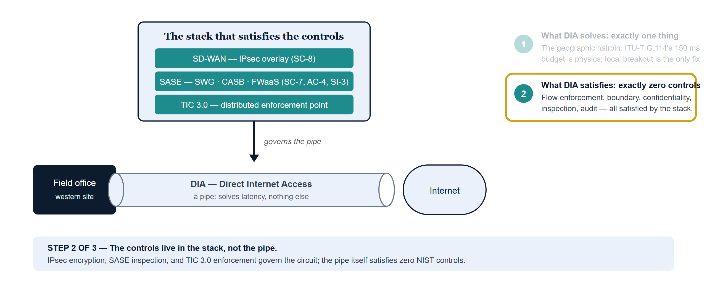
DIA Is a Pipe — The Three-Step Argument
Direct Internet Access solves the latency problem; the governance stack satisfies the controls
Federal AAN — Executive Summary · CSI Team Draft — Internal, Not for Public Distribution · Date Code 2026-07-07 15:28 ET
9
Notes:
BUILD 2 OF 3 — What DIA satisfies: exactly zero NIST controls. Information flow enforcement (AC-4), boundary protection (SC-7), transmission confidentiality (SC-8), inline malware inspection (SI-3), monitoring, and audit are all satisfied by the SD-WAN / SASE / TIC 3.0 stack that governs the pipe — never by the pipe itself. Under TIC 3.0 the relationship is not advisory: DIA is permissible only when the security-capabilities catalog is satisfied at the distributed enforcement point, which is the SASE stack. Presenter cue: advance for what happens when an agency deploys the pipe without the stack.
Vendor sources: https://csrc.nist.gov/pubs/sp/800/53/r5/upd1/final | https://www.cisa.gov/resources-tools/programs/trusted-internet-connections-tic

Slide 10
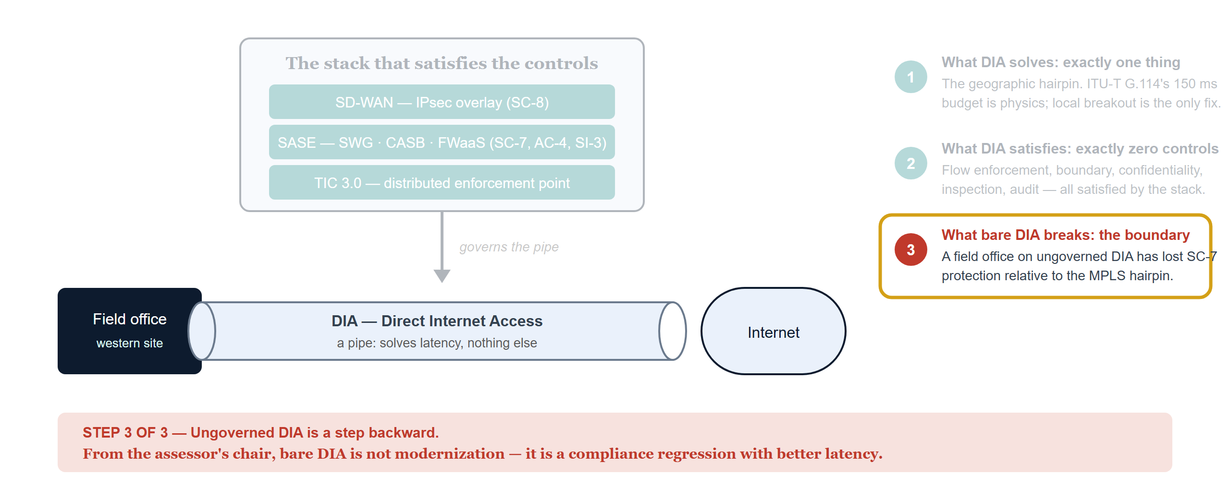
DIA Is a Pipe — The Three-Step Argument
Direct Internet Access solves the latency problem; the governance stack satisfies the controls
Federal AAN — Executive Summary · CSI Team Draft — Internal, Not for Public Distribution · Date Code 2026-07-07 15:28 ET
10
Notes:
BUILD 3 OF 3 — What bare DIA breaks: the boundary it replaced. A field office moved from the MPLS/TIC 2.0 hairpin to ungoverned DIA has LOST SC-7 boundary protection relative to its starting point. From the assessor's chair, bare DIA is not modernization — it is a compliance regression with better latency. Context for questions: both telecom platforms fail G.114 under the current hairpin — Amazon Connect (the N8NN national inbound contact center, on AWS commercial by specific authorized exception) and Microsoft Teams Phone. The same SD-WAN/SASE investment fixes both without modification; it does not need to be purchased twice. Amazon Connect additionally requires SA-9 (SSP entry with the exception narrative, recording S3 location, API logging), AU-9 (KMS + S3 access logging for recordings containing PII), and IA-8 (Entra-to-Connect SAML assertion logging, KSI-verifiable).
Vendor sources: https://www.cisa.gov/resources-tools/programs/trusted-internet-connections-tic | https://csrc.nist.gov/pubs/sp/800/53/r5/upd1/final

Slide 11
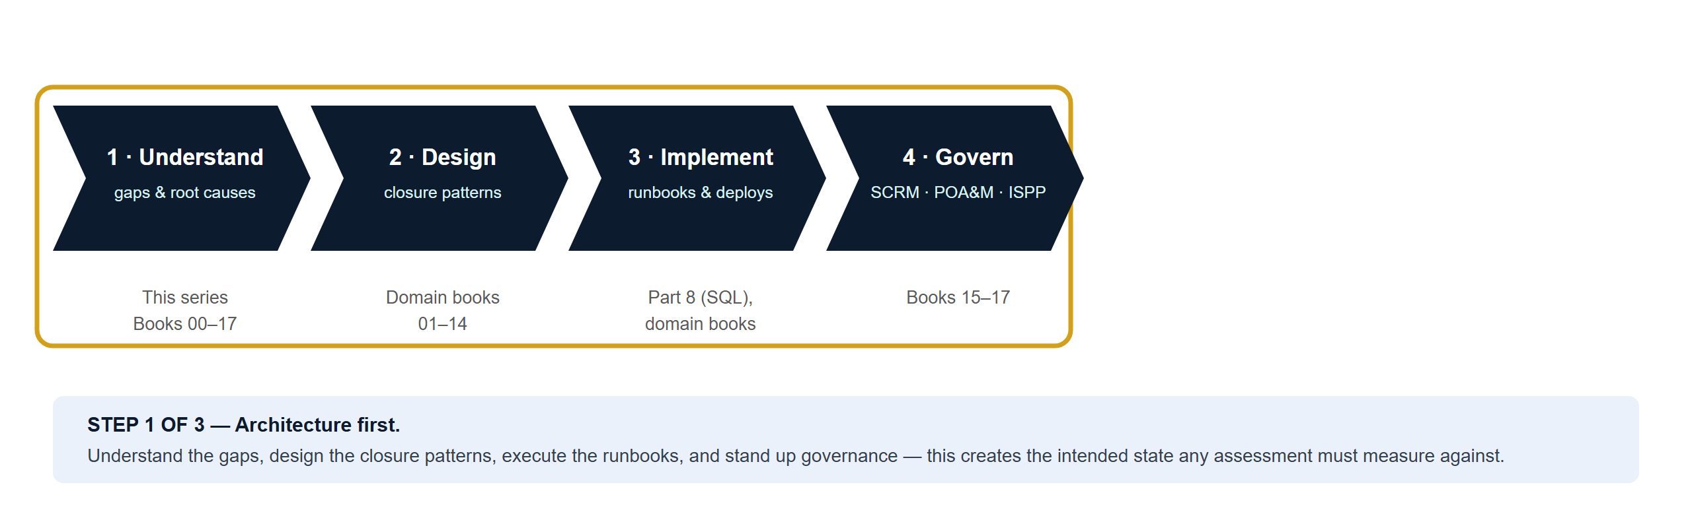
Architecture Before Assessment
Why SCuBA, ZTTT, and Secure Score cannot be the starting point
Federal AAN — Executive Summary · CSI Team Draft — Internal, Not for Public Distribution · Date Code 2026-07-07 15:28 ET
11
Notes:
BUILD 1 OF 3 — Phases 1-4: the architecture work comes first. Understand the control gaps and their architectural root causes (this series, Books 00-17); design the pattern that closes each gap with continuous evidence (domain books 01-14); implement via the runbooks (Part 8 for SQL, domain books); establish governance — SCRM, POA&M, ISPP, RACI (Books 15-17). This work creates the intended state that any assessment must measure against. Agencies that run SCuBA or ZTTT before this exists are reading a thermometer before the treatment plan exists: the findings are accurate, but there is no framework to act on them coherently — a list of open controls addressed piecemeal.
Vendor sources: https://www.cisa.gov/resources-tools/services/secure-cloud-business-applications-scuba-project | https://learn.microsoft.com/en-us/defender-xdr/microsoft-secure-score

Slide 12
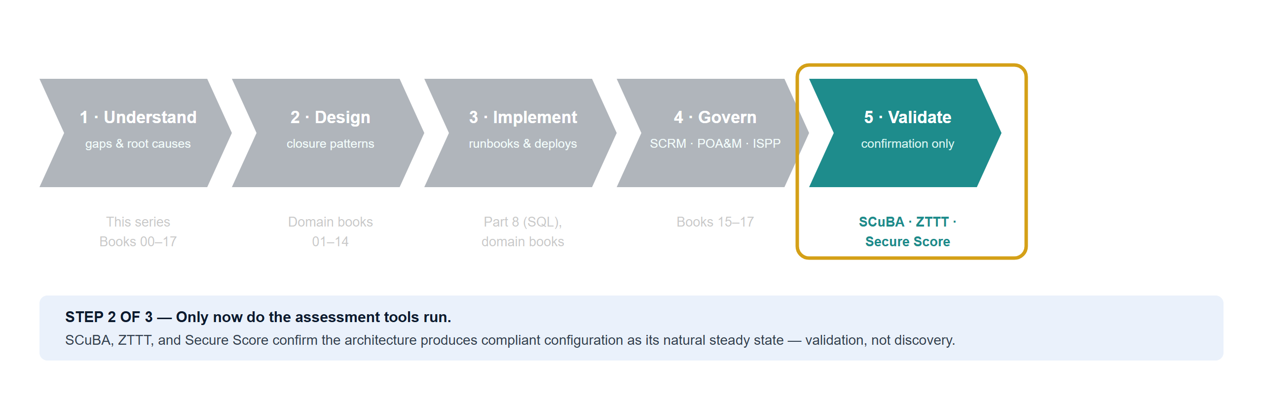
Architecture Before Assessment
Why SCuBA, ZTTT, and Secure Score cannot be the starting point
“Assessment tools tell you your blood pressure. They do not design your cardiovascular system.”
Federal AAN — Executive Summary · CSI Team Draft — Internal, Not for Public Distribution · Date Code 2026-07-07 15:28 ET
12
Notes:
BUILD 2 OF 3 — Phase 5: validation is where the assessment tools belong. SCuBAGear audits Microsoft 365 GCC tenant configuration (Exchange, Teams, SharePoint, Entra, Defender); ZTTT scores position within Microsoft's Zero Trust model; Secure Score tracks tenant posture. Run at Phase 5 they are a confirmation, not a discovery exercise: SCuBAGear should return a near-clean baseline report — not because settings were configured to pass the scan, but because the architecture produces compliant configuration as its natural steady state. "Assessment tools tell you your blood pressure. They do not design your cardiovascular system." Vendor sources: https://github.com/cisagov/ScubaGear · https://www.cisa.gov/resources-tools/services/secure-cloud-business-applications-scuba-project · https://learn.microsoft.com/en-us/security/zero-trust/ (ZTTT) · https://learn.microsoft.com/en-us/defender-xdr/microsoft-secure-score

Slide 13
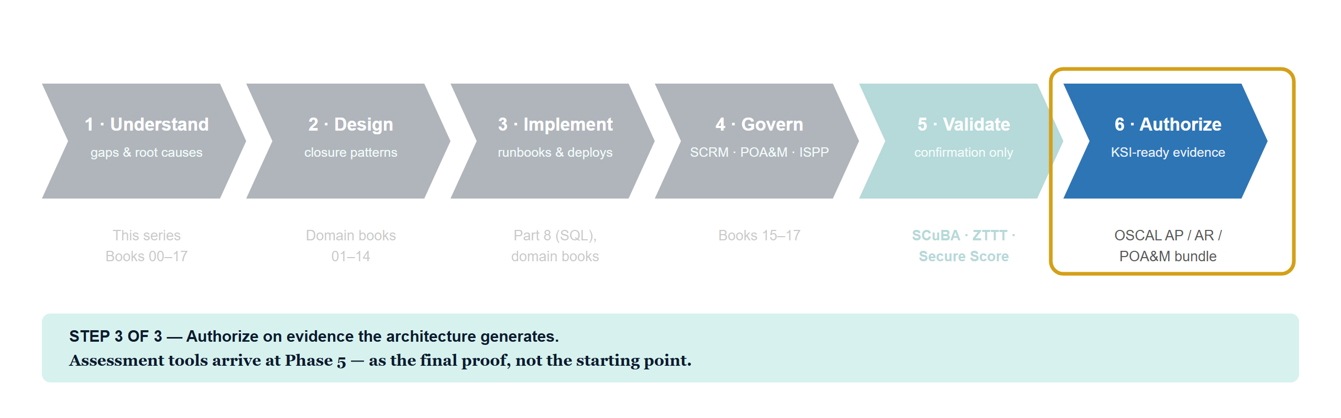
Architecture Before Assessment
Why SCuBA, ZTTT, and Secure Score cannot be the starting point
Federal AAN — Executive Summary · CSI Team Draft — Internal, Not for Public Distribution · Date Code 2026-07-07 15:28 ET
13
Notes:
BUILD 3 OF 3 — Phase 6: authorize on the evidence the architecture generates. The OSCAL AP/AR/POA&M bundle submits KSI-ready, machine-readable evidence to FedRAMP 20x evaluators. Single-vendor caveat for questions: federal compliance spans seven layers — network (DDI/DNSSEC/RPZ), transport (SD-WAN IPsec, QoS, DIA breakout), application (SASE SSE), identity (Entra, Conditional Access, Arc MI), data (SQL, TDE, replication physics), operations (Sentinel, XDR), governance (POA&M, SCRM, SBOM/VDR). No single-vendor assessment tool spans all seven; an agency relying solely on SCuBA or ZTTT has assessed one part of the surface and left the rest unmeasured and undefended. Vendor sources: https://github.com/cisagov/ScubaGear · https://learn.microsoft.com/en-us/security/zero-trust/ (ZTTT) · https://www.fedramp.gov/20x/

Slide 14
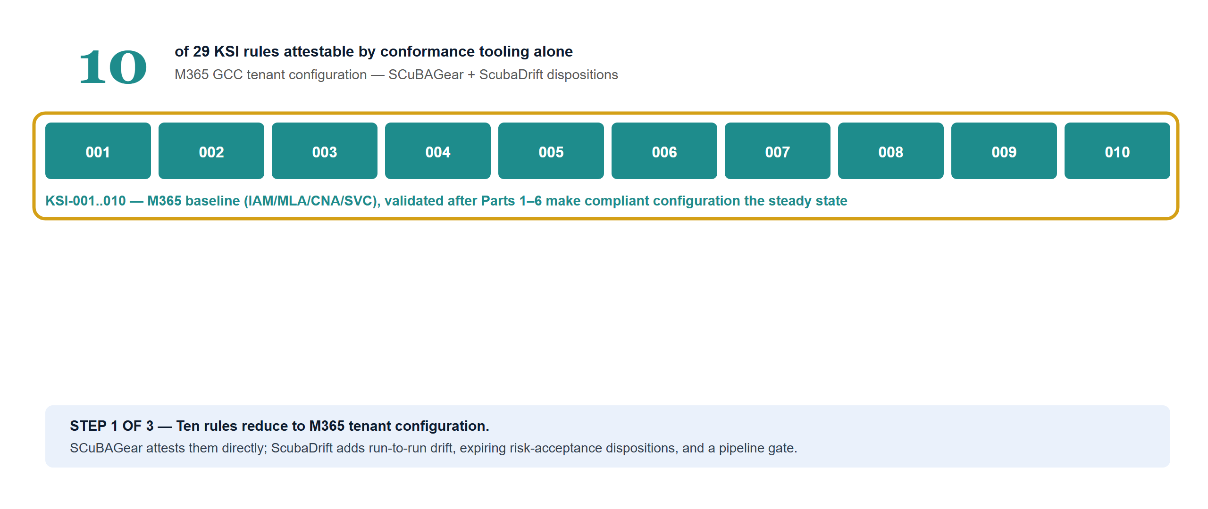
The Coverage Arithmetic — 10 of 29
The 29 FedRAMP 20x CR26 KSI rules, by what closes them — all verdicts self-assessed pending 3PAO validation
Federal AAN — Executive Summary · CSI Team Draft — Internal, Not for Public Distribution · Date Code 2026-07-07 15:28 ET
14
Notes:
BUILD 1 OF 3 — Ten of 29 rules reduce to M365 tenant configuration. KSI-001..010 are the M365 baseline themes (IAM/MLA/CNA/SVC) — exactly the surface SCuBAGear measures against the CISA SCuBA baseline. Even these ten are not point-in-time scans in this architecture: ScubaDrift adds the operational lifecycle — run-to-run drift, risk-acceptance dispositions with expiry, and a pipeline gate — so each verdict in the OSCAL AR carries its result, disposition, governing POA&M ticket, and expiry date (Book 19 §3.2 documents the pipeline). These validate after Parts 1-6 make the compliant baseline the natural steady state. Vendor sources: https://github.com/cisagov/ScubaGear · ScubaDrift is internal UIAO tooling: https://github.com/WhalerMike/uiao

Slide 15
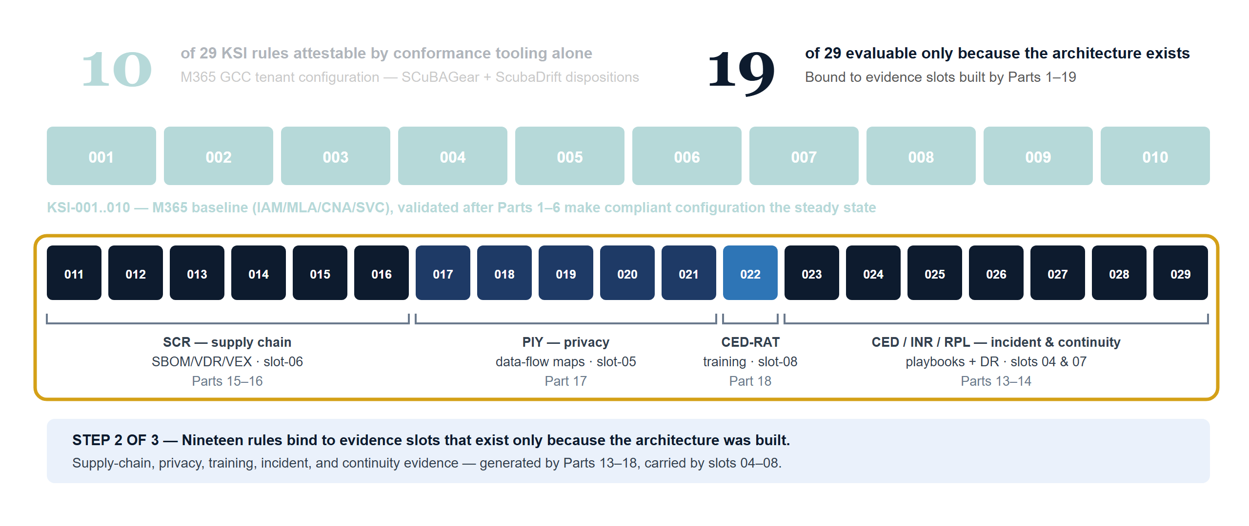
The Coverage Arithmetic — 10 of 29
The 29 FedRAMP 20x CR26 KSI rules, by what closes them — all verdicts self-assessed pending 3PAO validation
Federal AAN — Executive Summary · CSI Team Draft — Internal, Not for Public Distribution · Date Code 2026-07-07 15:28 ET
15
Notes:
BUILD 2 OF 3 — Nineteen rules exist as evaluable rules only because the architecture was built. KSI-011..014 (SCR, the VDR/VER contract): SBOM/VDR/VEX pipeline (Syft, Grype, OpenVEX) under BOD 26-04 — slot-06, Part 15. KSI-015..016 (SCR-MIT/MON): SCRM charter + continuous supply-chain monitoring — Parts 15-16. KSI-017..021 (PIY): privacy program, PII data-flow maps, Purview Data Map — slot-05, Part 17. KSI-022 (CED-RAT): machine-readable training-effectiveness record, LMS to Graph API export — slot-08, Part 18. KSI-023..029 (CED/INR/RPL): Sentinel/XDR incident playbooks + DR/continuity architecture — slots 04/07, Parts 13-14. Slot feeds: identity slot-01 draws on Parts 3/4/5/10; network slot-03 on Parts 1/2/6; data and telemetry slots 02/04 on Parts 10-12. Vendor sources: https://www.fedramp.gov/20x/ (CR26 KSI catalog)

Slide 16
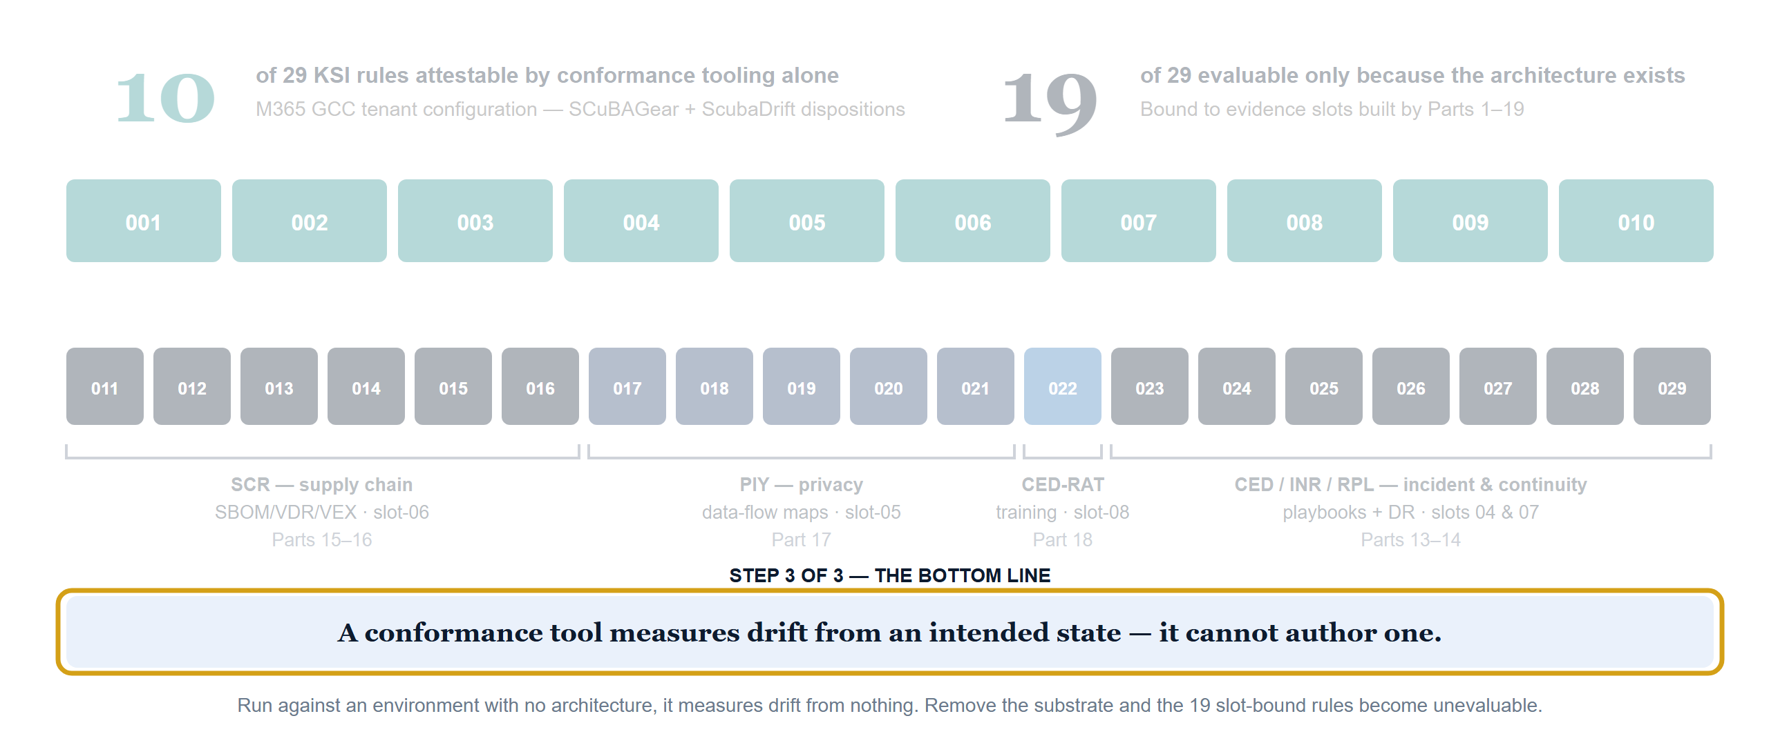
The Coverage Arithmetic — 10 of 29
The 29 FedRAMP 20x CR26 KSI rules, by what closes them — all verdicts self-assessed pending 3PAO validation
Federal AAN — Executive Summary · CSI Team Draft — Internal, Not for Public Distribution · Date Code 2026-07-07 15:28 ET
16
Notes:
BUILD 3 OF 3 — The bottom line: a conformance tool measures drift from an intended state; it cannot author one. Run against an environment with no architecture, it measures drift from nothing. Remove the substrate and the 19 slot-bound rules do not degrade — they become unevaluable. An agency whose KSI strategy is "run SCuBA and the Zero Trust toolkit" arrives at the January 1, 2027 mandatory date able to attest one third of the catalog, with no evidence pipeline for the rest. All verdicts are self-assessed pending independent 3PAO validation.
Vendor sources: https://www.cisa.gov/resources-tools/services/secure-cloud-business-applications-scuba-project | uiao repo: inbox/Application Aware Networking/Book_00_FedAAN_Executive_Summary.qmd

Slide 17
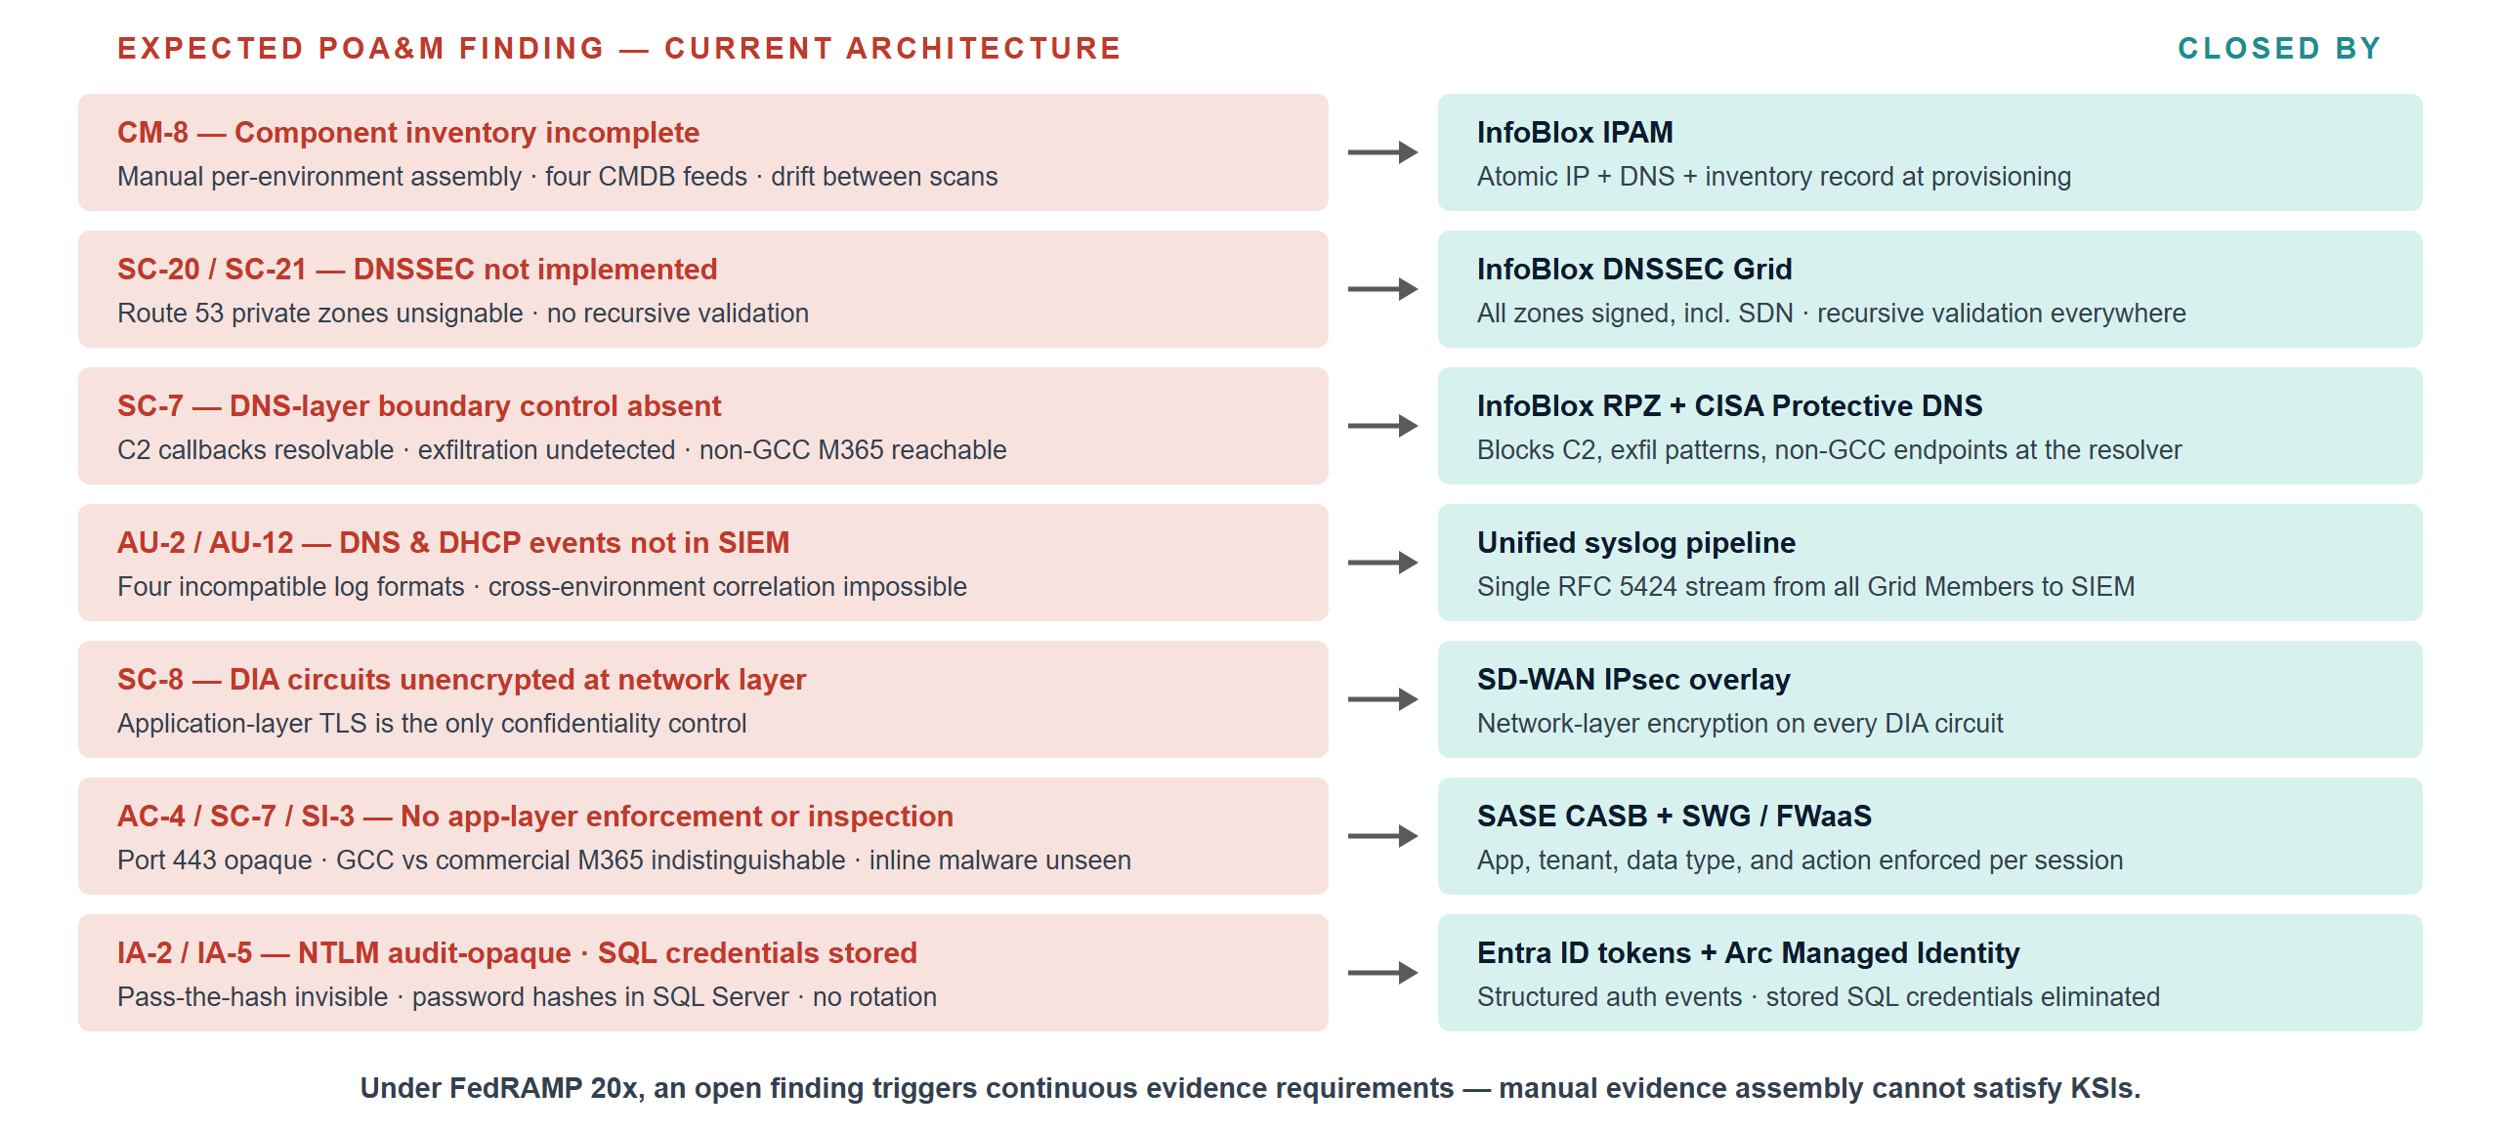
What an Assessor Documents Today
Expected POA&M items under current architecture — and the architectural element that closes each
Federal AAN — Executive Summary · CSI Team Draft — Internal, Not for Public Distribution · Date Code 2026-07-07 15:28 ET
17
Notes:
FULL EXPECTED-FINDINGS TABLE (13 rows in Book 00; the slide condenses to 7). Each row = an expected POA&M item under current architecture: 1. CM-8 component inventory incomplete — IP inventory assembled manually per environment; four CMDB feeds with inconsistent update cycles; VM additions not captured at provisioning. Root cause: no unified IPAM. Closed by InfoBlox IPAM — atomic IP+DNS+inventory record at workload creation. 2. SC-20/SC-21 DNSSEC not implemented — AWS Route 53 private zones cannot be DNSSEC-signed (documented platform gap); SDN segments not covered; no recursive validation. Closed by InfoBlox DNSSEC Grid (signs all zones incl. internal SDN; recursive validation everywhere). 3. SC-7 DNS-layer boundary control absent — C2 callback domains resolvable; DNS exfiltration undetected; no GCC-only M365 endpoint enforcement. Closed by InfoBlox RPZ + CISA Protective DNS feed. 4. AU-2/AU-12 DNS and DHCP events not in SIEM — four log formats; lease events not captured; cross-environment correlation impossible. Closed by InfoBlox unified syslog (single RFC 5424 stream, all Grid Members). 5. IA-9/SC-8 certificate-to-IP binding undocumented — mTLS enrollment manual/untracked; SCEP/EST not enforced at provisioning. Closed by InfoBlox PKI SCEP/EST — cert issued at provisioning, revoked at decommission, linked to IP host record. 6. SC-8 no network-layer encryption on DIA — application TLS is the only confidentiality control. Closed by SD-WAN IPsec overlay. 7. AC-4 application-layer information flow not enforced — GCC vs commercial M365 indistinguishable at network layer. Closed by SASE CASB (application, tenant, data type, user action per session). 8. SC-7 application-layer boundary protection absent on DIA — port 443 opaque; C2 on HTTPS undetectable. Closed by SASE SWG/FWaaS with inline SSL inspection at every DIA egress. 9. SI-3 inline malware inspection absent on DIA — malware over HTTPS reaches endpoints before SIEM detection. Closed by SASE SWG SSL inspection at nearest PoP. 10. AU-12 session records incomplete — flow logs lack user identity, device posture, application, action, data type; non-repudiation cannot be met. Closed by SASE per-session telemetry. 11. IA-2 NTLM authentication audit-opaque — no token-level events; pass-the-hash undetectable; NTLM fallback silent. Closed by Entra ID token-based authentication (structured, queryable events). 12. IA-5 SQL Server credential inventory undocumented — password hashes stored in SQL Server; no centralized rotation; orphaned logins undetected. Closed by Entra ID for SQL — logins eliminated; Managed Identity requires no stored credential; inventory becomes an Entra audit report. 13. CM-8 SQL Server estate undocumented — instances not fully enumerated; EoL posture unknown; linked-server dependencies unmapped. Closed by SQL estate discovery + continuous monitoring record. FEDRAMP 20x IMPLICATION: POA&M items no longer trigger periodic remediation deadlines — they trigger continuous evidence collection requirements. Findings that require manual evidence assembly cannot satisfy KSI requirements.
Vendor sources: https://csrc.nist.gov/pubs/sp/800/53/r5/upd1/final | uiao repo: inbox/Application Aware Networking/Book_00_FedAAN_Executive_Summary.qmd

Slide 18
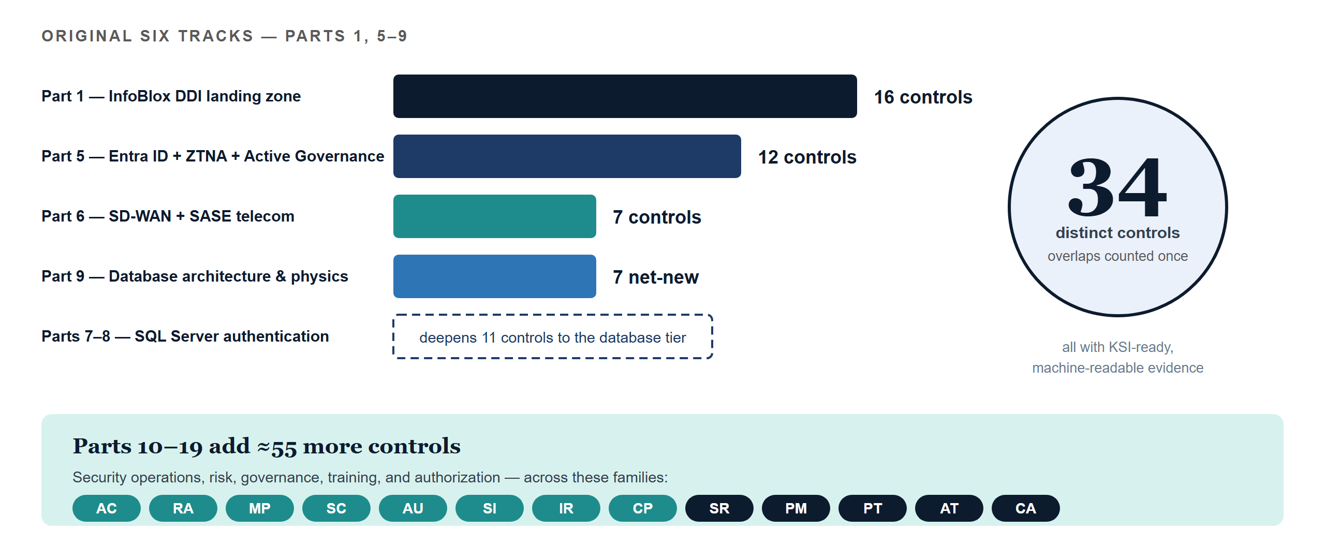
Control Closure Summary
Distinct NIST SP 800-53 Rev 5 controls closed, by implementation track
Federal AAN — Executive Summary · CSI Team Draft — Internal, Not for Public Distribution · Date Code 2026-07-07 15:28 ET
18
Notes:
CONTROL CLOSURE BY FAMILY (original six tracks — Parts 1, 5-9): - SC (System & Communications Protection): SC-5, SC-7, SC-7(7), SC-8, SC-8(1), SC-20, SC-20(1), SC-21, SC-22, SC-28 — InfoBlox DNSSEC/RPZ/PKI, SD-WAN IPsec, SASE SWG, TDE, QoS. Parts 1, 5, 6, 9. - CM: CM-2, CM-6, CM-8, CM-8(1) — InfoBlox IPAM, Active Governance, SQL estate inventory. Parts 1, 5, 7-8. - AU: AU-2, AU-9, AU-12 — InfoBlox syslog, SASE session logs, Entra logs, geo-replicated audit. Parts 1, 5, 6, 7-8, 9. - IA: IA-2, IA-2(1), IA-3, IA-5, IA-5(2), IA-8, IA-9 — InfoBlox PKI/SCEP, Entra Conditional Access, Intune MDM, Arc + Entra for SQL. Parts 1, 5, 7-8. - AC: AC-2, AC-3, AC-4, AC-17 — SASE CASB, ZTNA, Entra + OPM HRIT, SQL Entra groups. Parts 5, 6, 7-8. - CA: CA-3, CA-7. CP: CP-9, CP-10 (Part 9). IR: IR-4, IR-5 (Part 1). SA: SA-8, SA-9. SI: SI-3, SI-3(1), SI-4, SI-12. PL: PL-8 (InfoBlox inherited FedRAMP ATO). PER-TRACK COUNTS: Part 1 InfoBlox DDI = 16 controls (largest single evidence gap). Part 5 Entra+ZTNA+Active Governance = 12. Part 6 SD-WAN+SASE = 7 (DIA alone satisfies none). Parts 7-8 SQL = deepened closures of 11 controls to the database tier (IA-2, IA-3, IA-5, AC-2, AC-3, AC-17, AU-2/12, CA-7, CM-2/8, SC-8, SI-4). Part 9 = 7 net-new (SC-28, SC-5, CA-3, SA-8, AU-9, CP-9, CP-10). WHY 34 DISTINCT: several controls appear across multiple tracks (SC-7, SC-8, SC-20/21, AU-2/AU-12, CM-8, CA-7) at different layers — DNS-layer SC-7 in Part 1, network-layer in Part 6, database-layer auth in Parts 7-8. The 34 count is distinct control numbers; total implementation coverage is broader. PARTS 10-19 TARGET CONTROLS (~55 additional): P10 AC-5, AC-6(+1/2/5/7/9/10), AC-11, AC-12, IA-11. P11 RA-5(+2/5), SI-2(+2), SI-5, CM-7(+1). P12 MP-2..MP-5, SC-12, SC-13, SC-17, SC-28, AU-10. P13 AU-6(+1/3), AU-7, AU-8, AU-11, SI-4(+2/4/5), IR-4, IR-6, IR-8. P14 CP-2(+1/2/3), CP-3, CP-4(+1/2), CP-6, CP-7(+1/2/3), CP-8(+1/2). P15 SR-1/2/3/5/6/8/10/11. P16 PM-1/2/5/7/9/11/14/15/30. P17 PT-1/2/3/4/5/7. P18 AT-2(+1/2), AT-3(+3/5), AT-4, CP-3, IR-2. P19 CA-2, CA-5, CA-6, CA-7(+1/3), RA-3, SA-15. KSI ALIGNMENT: Parts 10-14 map to KSI-MLA, KSI-SVC, KSI-IAM; Part 13 (Sentinel) is the primary MLA evidence source; Parts 15-17 map to KSI-SCR / SCR-MON / PIY-RSD; Part 18 activates KSI-022; Part 19 converts evaluable state into the authorization package.
Vendor sources: https://csrc.nist.gov/pubs/sp/800/53/r5/upd1/final | uiao repo: inbox/Application Aware Networking/Book_00_FedAAN_Executive_Summary.qmd

Slide 19
What “Closed” Means Under FedRAMP 20x
Continuous, machine-readable Key Security Indicators replace periodic evidence assembly
A control is closed only when its evidence is:
Conformance Adapter and OSCAL emitter — current state
1
Automatic
Conformance Adapter schema | 29/29 KSIs mapped
Surface slots 1–8 | All bound to AAN evidence
OSCAL Assessment Plan | 10 themes · 32 CR26 controls
OSCAL Assessment Results | 29 findings · 0 open risks
OSCAL POA&M | 0 items — all KSIs satisfied
SCuBA adapter (KSI-001..010) | Active · continuous M365 assessment
Slot evaluator (KSI-011..029) | Active · high-confidence bindings
Generated by infrastructure — never assembled manually by staff
2
Machine-readable
Structured JSON via API — the native format for 20x KSIs
3
Continuous
Updated as the system runs — not point-in-time snapshots
4
Validatable
Checked programmatically against the published KSI schema
All KSI verdicts are self-assessed, pending independent 3PAO validation.
The architectural transition IS the FedRAMP 20x compliance posture — not a compliance project layered on top of operations.
uiao oscal bundle → 29/29 satisfied · 0 open risks · 0 POA&M items (run monthly for ConMon)
Federal AAN — Executive Summary · CSI Team Draft — Internal, Not for Public Distribution · Date Code 2026-07-07 15:28 ET
19
Notes:
WHAT "CLOSED" MEANS UNDER FEDRAMP 20x: the Consolidated Rules (June 25, 2026) replace periodic evidence assembly with continuously-verified, machine-readable Key Security Indicators. A control is closed when: (1) evidence is generated AUTOMATICALLY by infrastructure, not assembled manually by staff; (2) evidence is MACHINE-READABLE (structured JSON via API); (3) evidence is CONTINUOUSLY UPDATED, not point-in-time; (4) evidence can be VALIDATED PROGRAMMATICALLY against the published KSI schema on GitHub. ALL SIX TRACKS PRODUCE MACHINE-READABLE EVIDENCE NATIVELY: InfoBlox WAPI exports all DDI evidence as structured JSON (the only DDI platform generating KSI-compliant evidence without additional tooling); the SASE stack exports per-session telemetry in structured log format; the Active Governance control plane generates desired-vs-actual JSON records as its primary output; the SQL continuous-monitoring record exports login types, NTLM event count, and Managed Identity coverage as daily structured JSON; DR and backup records export RTO, RPO, and test-result timestamps as structured audit records. CONFORMANCE ADAPTER — CURRENT STATE (all components operational): Conformance Adapter schema complete, 29/29 KSIs mapped. Surface slots 1-8 all bound to AAN evidence (slot-08 training activated by Part 18). OSCAL AP complete — 10 themes, 32 CR26 controls. OSCAL AR complete — 29 findings, 0 open risks, 0 not-satisfied. OSCAL POA&M complete — 0 items, all KSIs satisfied. SCuBA adapter (KSI-001..010) active — continuous CISA SCuBAGear M365 assessment. Slot evaluator (KSI-011..029) active — high-confidence bindings for all active rules. BUNDLE GENERATION (run monthly for ConMon): uiao oscal bundle --system-name "SSA GCC Moderate" --output-dir output/artifacts/ksi-bundle → 29/29 satisfied, 0 open risks, 0 POA&M items. All verdicts self-assessed pending independent 3PAO validation. The architectural transition IS the FedRAMP 20x compliance posture — not a compliance project layered on top of operations. Vendor sources: https://pages.nist.gov/OSCAL/ · https://www.fedramp.gov/20x/ · Conformance Adapter and OSCAL emitter are internal UIAO tooling: https://github.com/WhalerMike/uiao

Slide 20
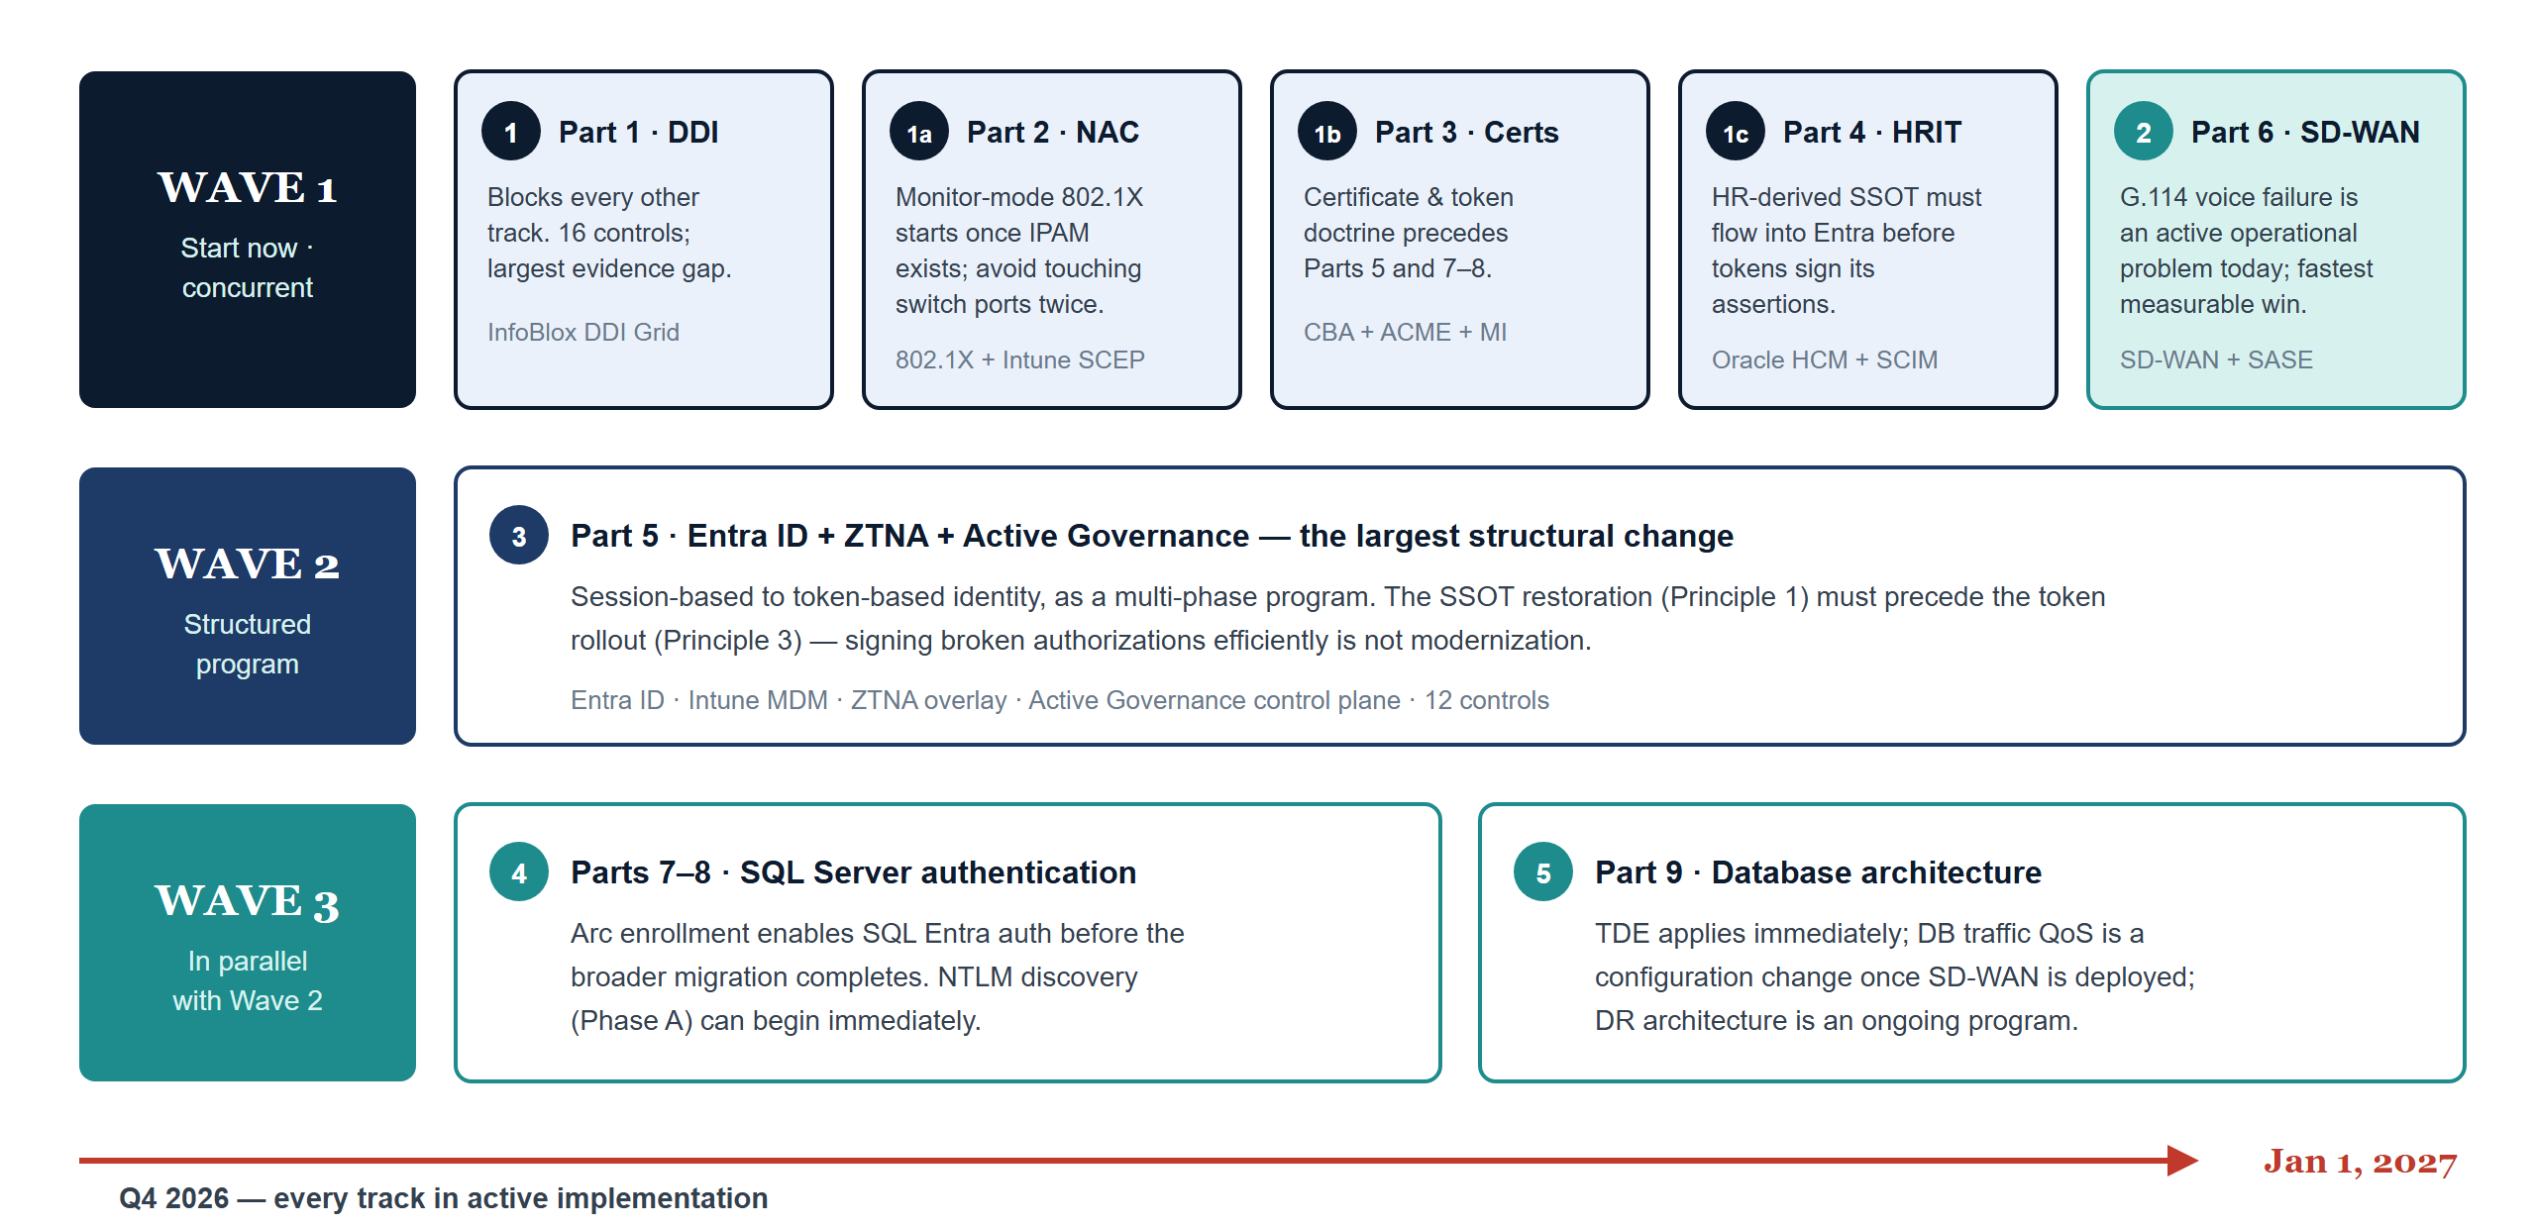
Implementation Priority and Sequencing
DDI first — it blocks everything else; the SSOT must flow before tokens sign its assertions
Federal AAN — Executive Summary · CSI Team Draft — Internal, Not for Public Distribution · Date Code 2026-07-07 15:28 ET
20
Notes:
IMPLEMENTATION PRIORITY AND SEQUENCING (full rationale): PRIORITY 1 — IMMEDIATE — Part 1 InfoBlox DDI Landing Zone: blocks every other implementation. DNS is the foundational naming layer; Zero Trust policy, ZTNA micro-tunnels, RPZ boundary enforcement, and certificate lifecycle all depend on a functioning DDI layer. Largest evidence gap — 16 controls with no automated evidence today. InfoBlox is FedRAMP Moderate-authorized (CSO FR2017257053, authorized January 2023, AWS GovCloud; verify current status on the FedRAMP Marketplace at procurement). PRIORITY 1a — CONCURRENT WITH PART 1 — Part 2 NAC: monitor-mode 802.1X and DHCP fingerprinting can begin as soon as IPAM exists — NAC's device inventory IS Part 1's IPAM. Deploying NAC while the DDI grid rolls out avoids re-touching every switch port twice. PRIORITY 1b — PRECEDES PARTS 5 AND 7-8 — Part 3 Certificates & Tokens: certificate and token doctrine is the prerequisite for identity modernization (Part 5) and SQL authentication (Parts 7-8); the certificate pipeline it establishes is the same one Part 2's machine certificates ride. PRIORITY 1c — PRECEDES PART 5 — Part 4 OPM HRIT Identity & Org SSOT (Oracle HCM Cloud + Entra inbound provisioning, Spec2-D3.1): Part 5's structural dependency is explicit — tokens work only if the authorization they assert is correct. The HR-derived SSOT must be flowing into Entra before the token rollout signs its assertions; the attribute-authority agreement and inbound provisioning pilot can start immediately alongside Part 1. PRIORITY 2 — CONCURRENT WITH PART 1 — Part 6 SD-WAN + SASE: the G.114 compliance failure (Amazon Connect latency) is an active operational problem generating citizen-facing quality failures TODAY. DIA + SASE is the fastest path to measurable operational improvement and closes 7 controls simultaneously. Vendor shortlists (selection pending): SD-WAN — Cisco Catalyst SD-WAN / VMware VeloCloud (Broadcom) / Palo Alto SD-WAN; SASE SSE — Zscaler ZIA / Netskope SSE / Palo Alto Prisma Access. PRIORITY 3 — STRUCTURED PROGRAM — Part 5 Entra ID + ZTNA + Active Governance: the largest structural change — replacing session-based with token-based identity. Plan as a multi-phase program; SSOT restoration (Principle 1) must precede token rollout (Principle 3). The four principles: restore a single source of truth (collapse twelve regional AD silos into one HR-derived model); deploy application-aware networking; move from session-based to token-based identity; implement active governance (a control plane that holds desired state, observes actual state, classifies drift, reconciles toward intent, and generates machine-readable evidence continuously). PRIORITY 4 — IN PARALLEL WITH PART 5 — Parts 7-8 SQL Server Authentication: Arc enrollment enables SQL Entra auth independently of the full AD-to-Entra migration; can begin on SQL instances before the broader migration completes. NTLM Phase A (discovery) can begin immediately. PRIORITY 5 — CONCURRENT WITH PARTS 7-8 — Part 9 Database Architecture: TDE can be applied immediately; SD-WAN QoS for database traffic is a configuration change once SD-WAN is deployed; DR architecture is an ongoing program. Vendor sources: https://marketplace.fedramp.gov/ (InfoBlox CSO FR2017257053 — verify current status) · https://www.infoblox.com/ · SD-WAN shortlist: https://www.cisco.com/site/us/en/solutions/networking/sdwan/index.html · https://www.vmware.com/products/velocloud-sd-wan.html · https://www.paloaltonetworks.com/sase · SASE SSE shortlist: https://www.zscaler.com/products-and-solutions/zscaler-internet-access · https://www.netskope.com/products/next-gen-swg · https://www.oracle.com/human-capital-management/ · https://learn.microsoft.com/en-us/entra/ · https://learn.microsoft.com/en-us/azure/azure-arc/

Slide 21
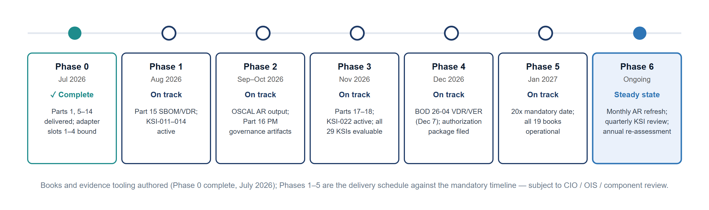
Phased Delivery Roadmap
Phase 0 through Phase 6 — from series delivery to continuous-monitoring steady state
Next step: formal alignment. CIO Office, OIS, organizational leaders, and program offices must review, revise, and own this roadmap — the January 1, 2027 date does not move while they do.
Federal AAN — Executive Summary · CSI Team Draft — Internal, Not for Public Distribution · Date Code 2026-07-07 15:28 ET
21
Notes:
PHASED DELIVERY ROADMAP. Note on status: the Book 00 roadmap table marks all phases complete, reflecting that the books and evidence tooling have been AUTHORED. As of July 2026 only Phase 0 has actually elapsed; Phases 1-5 are the delivery schedule against the mandatory timeline and are shown here as ON TRACK, subject to CIO / OIS / component review. Phase 0 (July 2026 — COMPLETE): Parts 1 and 5-14 delivered; Conformance Adapter slots 1-4 bound. Phase 1 (August 2026 — on track): Part 15 SR/SBOM/VDR; adapter SR slot bound; KSI-011-014 become active. Phase 2 (Sep-Oct 2026 — on track): OSCAL Emitter AR output; Part 16 PM governance artifacts; CR26 SR/PM rules. Phase 3 (November 2026 — on track): Part 17 PT/PII templates; Part 18 AT training program; KSI-022 active; all 29 CR26 KSIs evaluable. Phase 4 (December 2026 — on track): BOD 26-04 VDR/VER submission (due Dec 7); authorization package filed; OSCAL AP+AR+POA&M bundle (29/29 self-assessed, pending 3PAO validation). Phase 5 (January 2027 — on track): FedRAMP 20x mandatory deadline; all 19 books operational; continuous monitoring cadence established. Phase 6 (from January 2027 — steady state): monthly OSCAL AR refresh; quarterly KSI evidence review; annual full re-assessment; ATO renewal preparation. TECHNOLOGY RECOMMENDATIONS BY GAP: SBOM generation — Syft (Anchore) or Trivy, integrated into CI/CD. VDR format — CycloneDX 1.6 (XML or JSON), CISA-preferred. VER submission — CISA VEX Portal or email per BOD 26-04 guidance. OSCAL AP/AR — trestle (IBM) or custom Python emitter against the OSCAL 1.1 schema. PII mapping — Purview Data Map + sensitivity-label lineage (extends Part 12). PM metrics — Sentinel workbook for AU/CA/PM KPI dashboard (extends Part 13). CLOSING MESSAGE: the architectural transition described in this series IS the FedRAMP 20x compliance posture — not a compliance project layered on top of operations. Next step is formal alignment: CIO Office, OIS, organizational leaders, and program offices must review, revise, and own this roadmap. The January 1, 2027 date does not move while they do.
Vendor sources: uiao repo: inbox/Application Aware Networking/Book_00_FedAAN_Executive_Summary.qmd

Slide 22
The Federal Compliance Clock
Every deadline running against the controls this series closes — SSOT: the Federal AAN / ConMon Gap Roadmap (verified 2026-07-07)
Aug 3 / 31, 2026 FedRAMP 20x opens — Class A, then Class B + C: the GCC Moderate window (marketplace Jul 6; Ready legacy Jul 28; Rev5 conversion Aug 10)
Aug 7, 2026 BOD 26-04: agency vulnerability-management policies must support risk-based remediation (four-variable model, 3-day tier to deferral)
Sep 21, 2026 FIPS 140-2 certificates move to NIST's Historical List — verify cryptographic modules are FIPS 140-3 tracked (SC-13)
Dec 7, 2026 BOD 26-04 remediation timelines in force + FedRAMP VDR/VER mandatory — SBOM and vendor disclosure required
Jan 1, 2027 FedRAMP CR26 mandatory for all · CNSA 2.0 acquisition gate (NSS-scoped; civilian PQC trajectory follows via M-23-02)
Jun 11, 2027 No new Rev5 certifications accepted
~Aug 2027 Next scheduled NIST 800-53 release — Release 5.2.0 (Aug 2025) already added SA-15(13), SA-24, SI-2(7), unmapped in Parts 11/15
2030 / 2035 Quantum-vulnerable cryptography deprecated, then prohibited — M-23-02 crypto inventories run to the 2035 horizon
Already in force: M-21-31 logging (EL3 Aug 2023) · M-21-07 IPv6 (80% FY2025) · M-22-09 Zero Trust (FY2024 goals; continued by M-24-14 / M-25-04) · BOD 25-01 SCuBA (policies Jun 20, 2025).
Federal AAN — Executive Summary · CSI Team Draft — Internal, Not for Public Distribution · Date Code 2026-07-07 15:28 ET
22
Notes:
The federal compliance clock — added in the 2026-07-07 timeline pass. The fully-sourced version, including the elapsed baseline, lives in the Federal AAN / ConMon Gap Roadmap — the series' single source of truth for federal dates. Walk the rows: August 3 and 31, 2026 — FedRAMP 20x submission windows open, Class A first, then Class B and C, the GCC Moderate window; marketplace listings opened July 6, FedRAMP Ready went legacy July 28, and temporary Rev5 conversion paths opened August 10. August 7, 2026 — BOD 26-04 (issued June 10, 2026) requires agency vulnerability-management policies to support risk-based remediation under its four-variable model (exposure, KEV listing, exploit automatability, technical impact) with timelines from 3 days to deferral. September 21, 2026 — every FIPS 140-2 certificate moves to NIST's Historical List, ending new procurement reliance on 140-2-only modules; verify FIPS 140-3 tracking. December 7, 2026 — BOD 26-04's remediation timelines take force AND FedRAMP's VDR/VER rules become mandatory: SBOM plus vendor disclosure (the Part 15 pipeline; KSI-011..014 become evaluable). January 1, 2027 — the Consolidated Rules become mandatory for all FedRAMP systems, and CNSA 2.0's acquisition gate opens for National Security Systems (ML-KEM-1024, ML-DSA-87; NSS-scoped, civilian trajectory follows via M-23-02). June 11, 2027 — no new Rev5 certifications. Around August 2027 — the next scheduled NIST 800-53 release on the two-year cadence; Release 5.2.0 (August 27, 2025) already added SA-15(13), SA-24, and SI-2(7), which are not yet mapped in Parts 11/15 — a tracked action item in the roadmap. 2030 and 2035 — quantum-vulnerable cryptography deprecated, then prohibited; M-23-02's annual inventories run to that horizon. The bottom bar lists the mandates already in force: M-21-31 logging tiers, M-21-07 IPv6 targets, M-22-09 Zero Trust (goals past due but still measured via FISMA/CDM), and BOD 25-01 SCuBA policies.
Vendor sources: https://www.fedramp.gov/20x/ | https://www.cisa.gov/news-events/directives/bod-26-04-prioritizing-security-updates-based-risk | https://csrc.nist.gov/News/2025/nist-releases-revision-to-sp-800-53-controls | uiao repo: inbox/Application Aware Networking/federal-aan-conmon-gap-roadmap.md

